Slide 1
How To Apply Indigenous Teacher Education ~ Community-Based Program
2024 Admissions

Slide 2
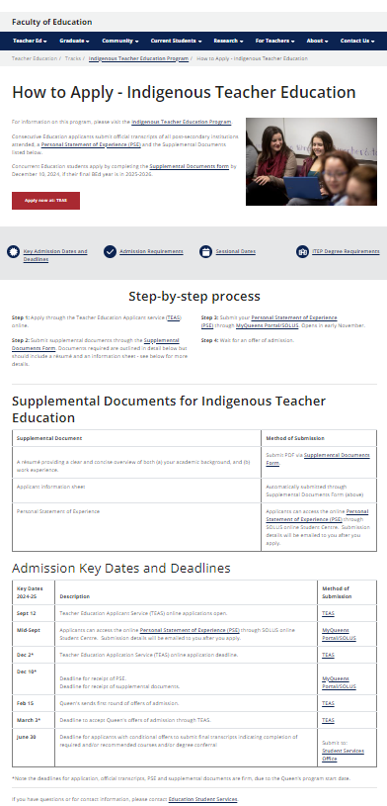
How to Apply - Indigenous Teacher Education
Start here
Visit:
https://educ.queensu.ca/teacher-education/tracks/itep/apply
Part 1 – Complete an OUAC/TEAS application
Part 2 – Complete and submit Supplementary Documents
Part 1
Part 2
Part 2
Application Deadline is December 2nd for OUAC TEAS & December 10th for Supplementary Documents

Slide 3
Part 1 Application Process ~ OUAC/TEAS DEADLINE: December 2

Slide 4
Create an OUAC account
Visit: https://www.ouac.on.ca/apply/dashboard/en_CA/user/login
Keep track of your username and password so you can return later to continue working on your application

Slide 5
Choose Teacher Education (TEAS)

Slide 6
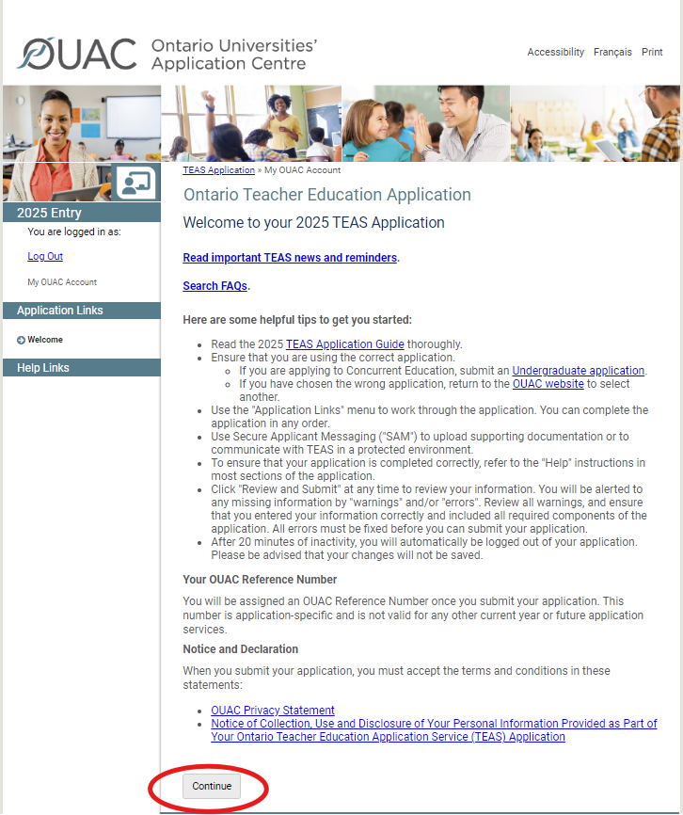
Click here

Slide 7
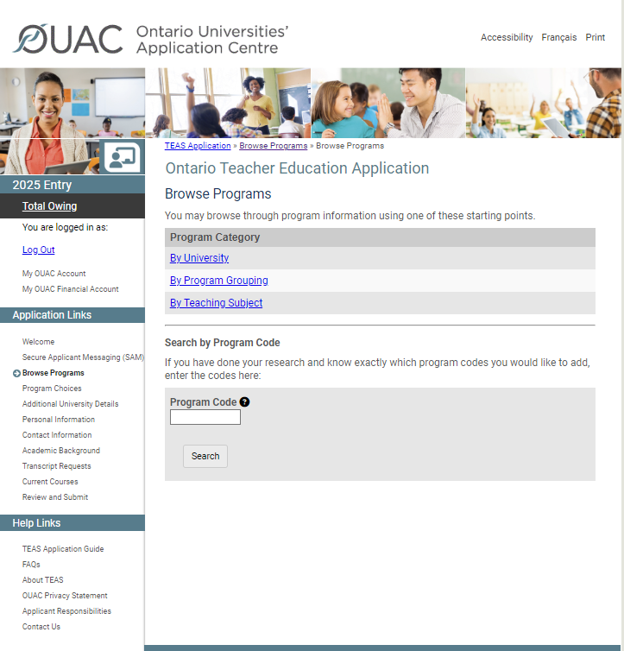
Select the site you want to apply to:
Q11 – Queen’s – Indigenous Teacher Education Community-Based – Tyendinaga
Q13 – Queen’s – Indigenous Teacher Education Community-Based – Mushkegowuk Territory
Q14 – Queen’s – Indigenous Teacher Education Community-Based – Manitoulin North Shore
Q16 – Queen’s – Indigenous Teacher Education Community-Based – Lambton-Kent
Q40 – Queen’s – Indigenous Teacher Education Community-Based – Pikangikum
Click here

Slide 8
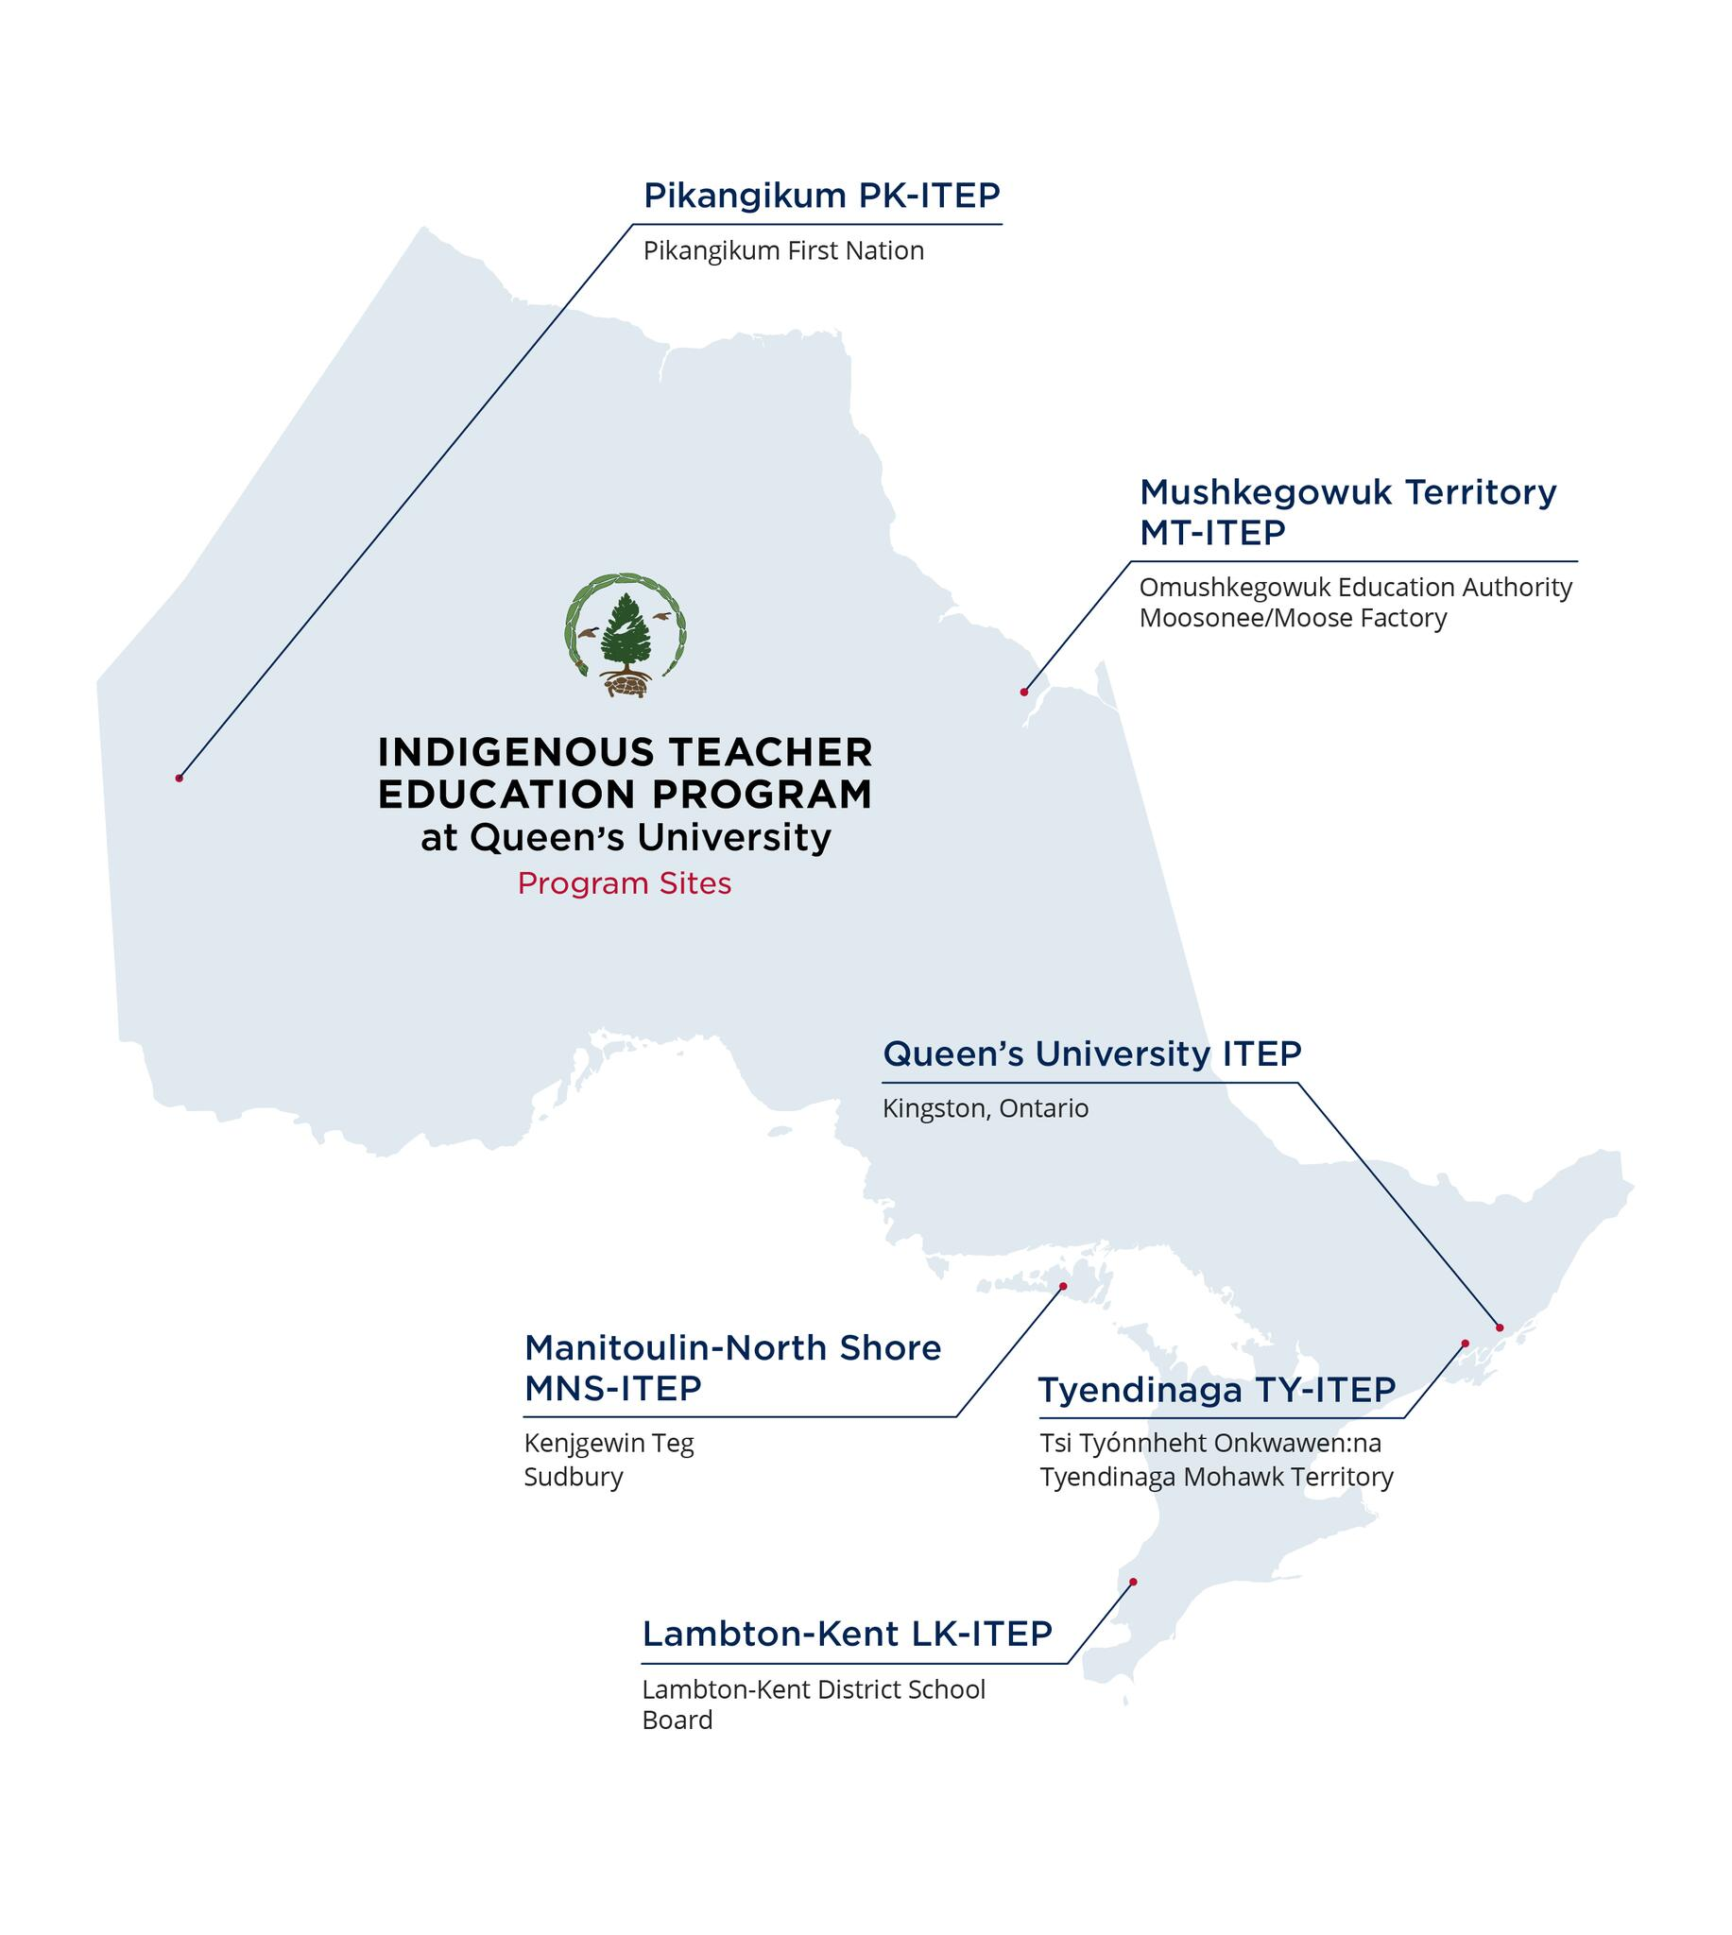
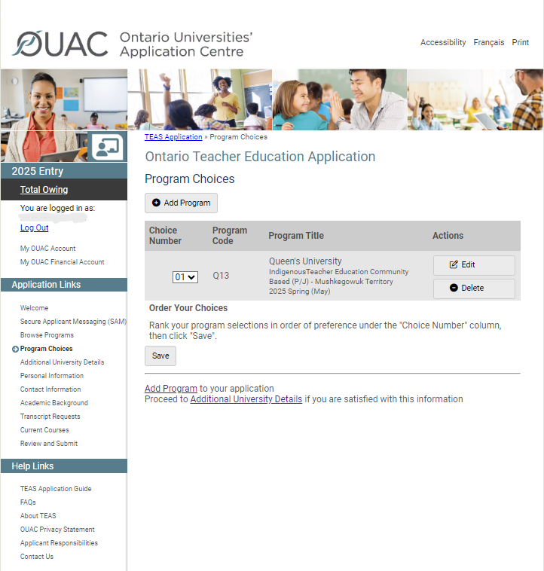
Please only apply to ITEP Community-Based sites that you are prepared to attend
in-person.
Map of Queen’s ITEP Community-Based Sites

Slide 9
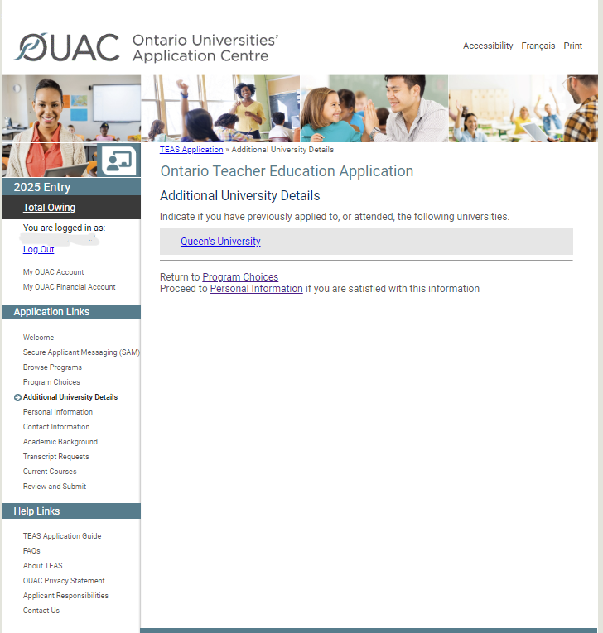
For the links on the left side of the page, you will need to fill in your personal details. Please work through each link outlined in red

Slide 10
Do not pay fees YET!
STEP ONE:
Email educmultisessions@queensu.ca and provide the name and email address used to create your account, and your OUAC username.
Queen’s University will waive your Queen’s Supplementary fee ($85).
Wait for confirmation from Queen’s that your fee has been waived.
STEP TWO:
Order your post-secondary transcript(s) through OUAC/TEAS, if applicable.
Once you receive confirmation from Queen’s that the Supplementary fee has been waived, login to your OUAC/TEAS to complete your application.
Submit your application.
Pay the OUAC/TEAS application fee and transcript fee(s). Once the fees are paid, the application is sent to OUAC/TEAS.
Then you’ll need to do Part 2 of the application.

Slide 11
Part 2 Application Process ~ Supplemental Documents DEADLINE: December 10

Slide 12
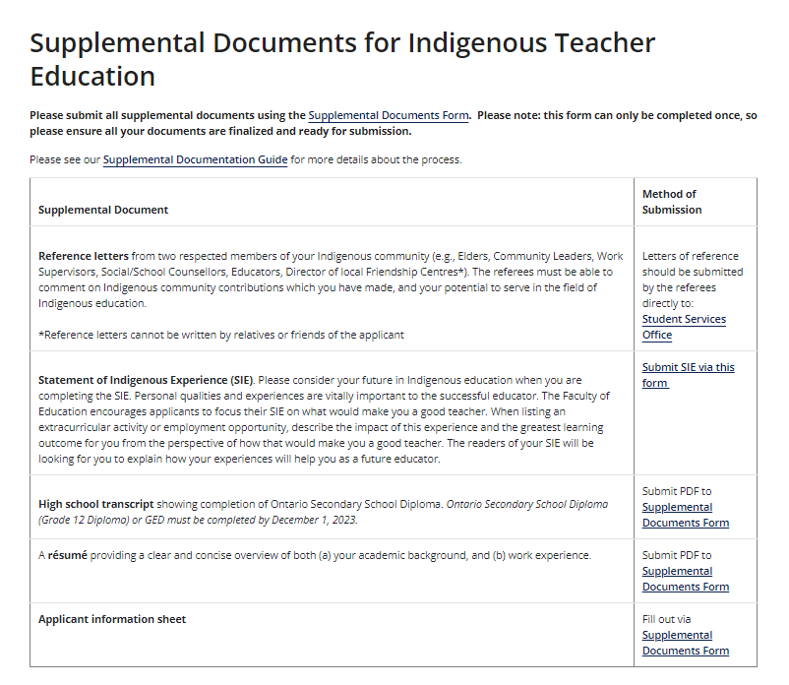
Visit: https://educ.queensu.ca/teacher-education/consecutive/itep-community/apply
Link: How to Apply - Indigenous Teacher Education Community-Based | Faculty of Education (queensu.ca)
Scroll down the page to see the Supplemental Documents information
Please check the method of submission section for the live links

Slide 13
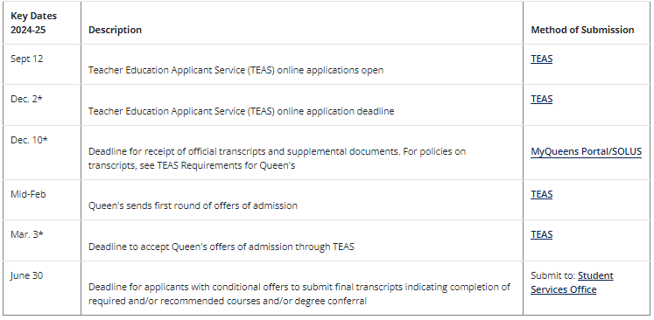
Key Dates and Deadlines
*IMPORTANT: The deadlines for application, official transcripts, and supplemental document submission are firm.

Slide 14
Find out more!
Join us for a webinar to find out more about our Indigenous Teacher Education (community-based) program.
October 29, 7 pm EST, Zoom Registration
November 7, 7 pm EST, Zoom Registration
Watch the Youtube video:
Indigenous Teacher Education Program - Community-Based at Queen's University

