Slide 1
Fort Erie's
Black History
People & Places
MANDY TAYLOR USSRF

Slide 2
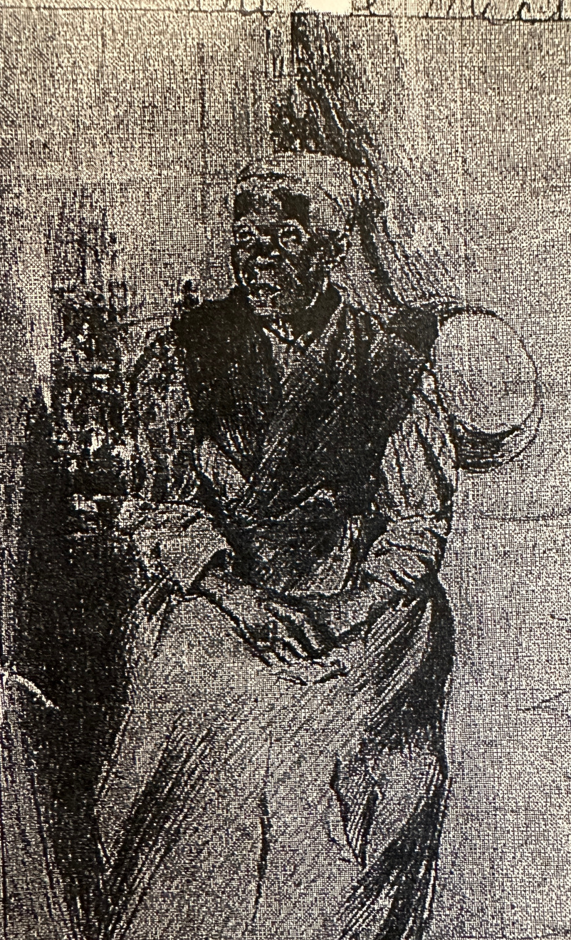
People of Fort Erie
Josiah Henson
Aunt Betsy
Burr Plato
Harriet
Tubman
MANDY TAYLOR USSRF
Notes:
Have students split up into four groups and read one of the four articles on a person of focus. Have them create jot notes to summarize each person with the following guidelines:
1.) When did the person arrive to Fort Erie / Canada?
2.) Where did the come from?
3.) Did they stay in Fort Erie/ where did they end up?
4.) What is their purpose?
5.) How did they make history, big or small?
6.) What is something that surprised you about their story?
7.) List three interesting things about this person

Slide 3
Josiah Henson
Born in 1789 into slavery
Josiah saw his father killed for defending his mother, and his family (brothers and sisters) bid and sold off
Finally growing old of his reality Josiah, like many made the brave decision to be a freeman
In 1830 Josiah escaped from Maryland crossing into Fort Erie from Buffalo NY
Making a promise to the Captain of his boat to freedom Josiah promised to use his freedom well
Josiah hit the Canadian soil running, getting a job at Hibbard Farm working there from 1830 - 1833
From 1833 - 1836 Josiah moved on to Riseley farm, where he and others had meetings to discuss how to better their future and invest in their lives
1836 Josiah moved to Dresdon Ontario where, his meetings came to fruition creating the 'Dawn Settlement' a community for freed people
MANDY TAYLOR USSRF
Notes:
Notes taken from article in appendix (list appendix item #)
“Josiah Henson Arrives to Make New Life”
- October 28th 1830 Escaped from Buffalo to Fort Erie by Ferry landing between Catherine and Lavinia Street
“You see those trees,” said the noble-hearted captain, next morning, pointing to a group in the distance, “they grow on free soil, and as soon as your feet touch that, you’re a man. I want to see you go and be a freeman….”
“I will use my freedom well; I’ll give my soul to God”
- Shortly after Josiah landed in Fort Erie, he made quick work to use his freedom well, obtaining a job at Hibbard Farm, also bargaining a home on the farms property by Mr. Hibbard.
* “Although there was nothing there but bare walls and floors, we were all in a state of great delight, and my wife laughed and acknowledge that it was worth wile, and that it was better than a log cabin with an earth floor…”
- Not long after his time spent on the farm, Josiah found himself preaching to this community, shortly after he left the Hibbard Farm, Mr. Hibbard left an acre of Land for Josiah to set up a church, a church that is now St. Johns Anglican Church
- Josiah worked on this farm for 3 years before moving on to Riselay farm from 1883 – 1836.
- During his time at the Rieselay farm, Josiah gathered others to have meetings at his home, discussing that changes they wanted to see in their lives. Topics surrounded how they could invest their earnings in order to settle on lands and build a new life.
- From these meetings came the Dawn Settlement in Dresdon Ontario where Josiah settled with his family and where he wrote his autobiography

Slide 4
Aunt 'Betsy' Robinson
Once a slave along with her mother, father, and 6 siblings at a plantation in Virginia
Came to Fort Erie at or around 1837 as a slavery refugee
Formally Betsy Robinson, however well known as Aunt Betsy, settled at what was formally Nigger Hill (now Lavinia Street in Fort Erie)
While Aunt Betsy was not known for reformative efforts, she was one of the longest freed slave residents of Fort Erie, recounting how many of those freed moved up on and out of Fort Erie.
Aunt Betsy's story unlike many others, details that on her journey to freedom she witnessed a shift in the South. There were more good white people, who would help the slaves escape to freedom
MANDY TAYLOR USSRF
Notes:
Read from slide

Slide 5
Burr Plato
Was born into slavery in West Virginia in 1833
He swam across the Niagara River from Buffalo into Fort Erie when he was just 23 years old
Having no education he worked as a farm hand, while learning how to read and write
After honing his skills, Plato became an entrepreneur, opening his own horse and carriage business.
Plato did not stop there, he then ran for city council in Niagara Falls in 1886... and won.
Plato was one of the first black people elected to office and Canada, holding his position until 1901
MANDY TAYLOR USSRF

Slide 6
Harriet Tubman
A fearless revolutionary, Harriet Tubman single handedly led hundreds to freedom.
While not officially reported, Tubman was said to have made freedom crossings at Fort Erie many times in addition to her regular route in Niagara Falls and Queenston.
MANDY TAYLOR USSRF
Notes:
Harriet Tubmans story is incredible, and one that we will discuss further tomorrow. However it is important to mention her passing through Fort Erie as we move on to the second part of this module, 'places.'

Slide 7
Places of Fort Erie
LITTLE AFRICA
BERTIE HALL
FORSYTH FERRY
MANDY TAYLOR USSRF

Slide 8
Places of Fort Erie
ST. PAUL'S ANGLICAN CHURCH
BERTIE HALL
BLAC CREEK TAVERN
ERIE BEACH HOTEL
MANDY TAYLOR USSRF

Slide 9
Little Africa
Population averaged 80-200
Located east of Stevensville, spreading to the eastern part of Sunset Indian Trail (now Curtis Road)
Fruitful neighbourhood having its own church, school, and stores.
Those in its community worked in logging as the area was rich in black walnut, white oak, maple and other tree variety's. The business was so prosperous, many would chop wood for the Canada Southern Railway.
The only sign of little Africa today is a plaque, as well as a sign for the black cemetery with few headstones left standing.
MANDY TAYLOR USSRF

Slide 10
Bertie Hall
Located at 16-22 Phipps Street
Now famously know as the Doll house
Was built by William Forsyth, then acquired by Mildred m. Mahoney's Silber Jubilee Dolls' house Gallery.
In its prime it was used as a shelter for slaves who would hide out In the basement. Though it is said to have secret tunnels for slaves to use as passage.
MANDY TAYLOR USSRF

Slide 11
Forsyth Ferry Landing
Two landing spots; the main one located at the end of Bertie street, and the lower ferry landing located at the end of Catherine street.
Serviced ferries for 150 years from 1799 - 1949
This Ferry service was vital to the freedom of many slaves such as Josiah Henson and Aunt Betsy Robinson
This location is where many Blacks were baptized
MANDY TAYLOR USSRF

Slide 12
St. Pauls Anglican Church
Located at 32 Idylewylde St
Welcomed both white and Blacks including white allies such as William Forsyth and Charles Hibbard, both of whom are buried there.
Not only did Blacks and whites attend, there are records of several Black marriages that took place at the church as well as a few Blacks who are buried there.
MANDY TAYLOR USSRF

Slide 13
Erie Beach Hotel
Once was the prior site of Snake Hill Settlement (a community of about 100 escaped slaved)
Built to be an amusement park, that also had a small railway. The hotel was an amusement park, casino stadium, zoo and home to at the time the world's largest swimming pool.
Now demolished with some remnants at what is now Waverly Beach
MANDY TAYLOR USSRF
Notes:
This famous hotel was also home to the first meeting of the Niagara Movement (to be discussed further in day 3)

Slide 14
Black Creek Tavern
Located at 4301 Niagara Parkway
Built in 1828, it was previously a grocery store, hotel, post office, and jail.
During the 1850's It was a safe house for the underground railroad. Now It serves as a local hub with a great view and excellent food.
MANDY TAYLOR USSRF

Slide 15
Conclusion
Fort Erie was home to many incredible Black freedom seekers, and a pit stop to many on their way to freedom.
With hundreds of other untold stories, I encourage you to research and find more Black voices of Fort Erie
The places we have discussed thus far, a few others yet to be mentioned as well as a few surprise stops will all be visited on day 5 of our lesson.
MANDY TAYLOR USSRF

Slide 16
Homework & Resources
Read & Reflect
Read the Crystal Beach Riot article and write 150 words on your thoughts on the incident.
Further Information
Josiah Henson Documentary
https://www.tvo.org/video/documentaries/josiah
"Harriet" - Available on all streaming platforms
MANDY TAYLOR USSRF
Notes:
Have students read the riot of crystal beach reading and write 150 words on their thoughts on incident

