Slide 1

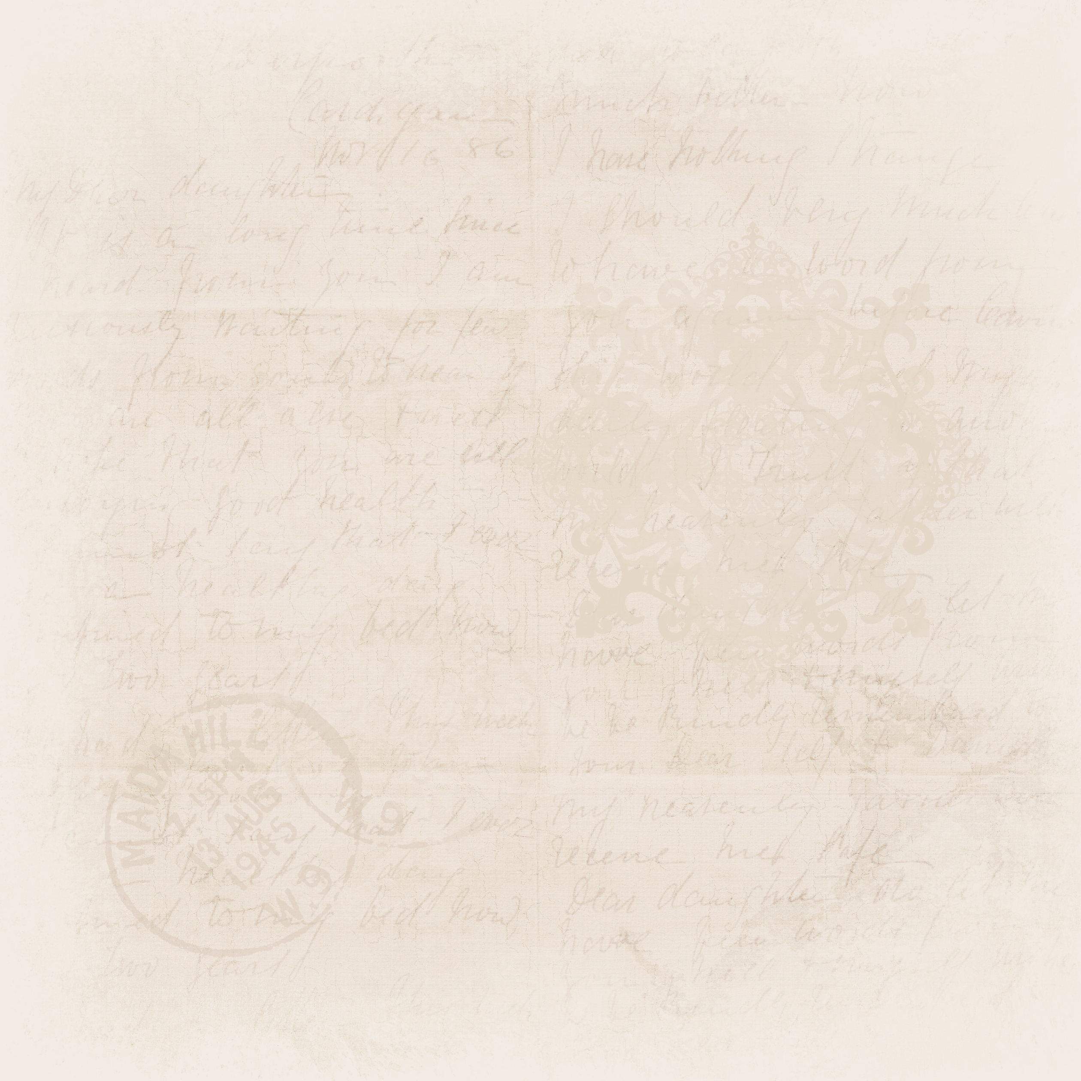



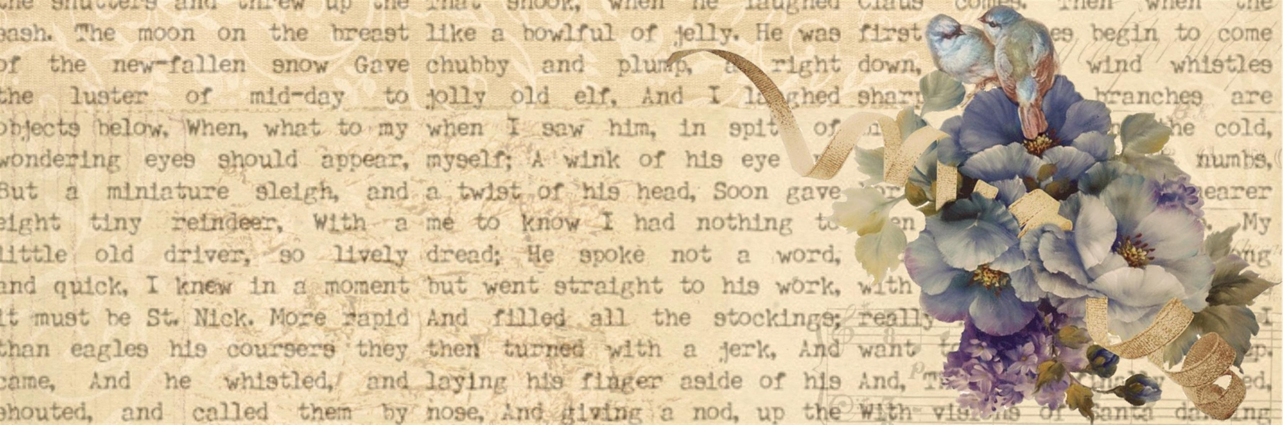






A Shared History
Fort Erie & Buffalo
MANDY TAYLOR USSRF

Slide 2

KAHOOT
https://create.kahoot.it/share/introduce-new-topics-with-a-blind-kahoot/63d530ce-01c4-438c-95ee-e5a233b25d5d
MANDY TAYLOR USSRF
Notes:
Recap of Day 1 & 2

Slide 3


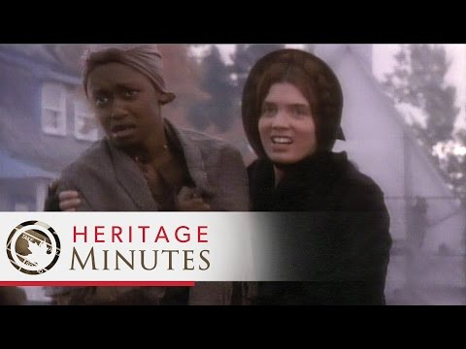
Underground Railroad
What is the underground railroad?
  A system structured by many networks comprised of both freed slaves and allied white people in the fight to free all those enslaved in America.
MANDY TAYLOR USSRF

Slide 4


Underground Railroad
  So, it wasn't an actual railroad?
  No, the 'system' is a set of pathways made secure by those freedom seekers. It was made accessible through the grapevine, song, and textile materials.
MANDY TAYLOR USSRF
Notes:
Extra video if needed:
https://www.youtube.com/watch?v=SlkE1qDnT4w

Slide 5
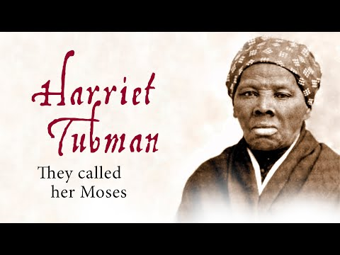
MANDY TAYLOR USSRF
Notes:
Reference for video

Slide 6


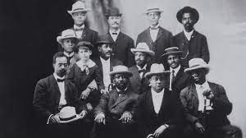
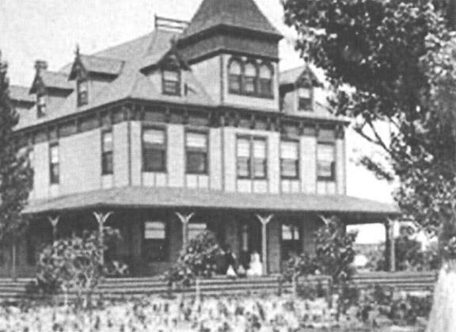
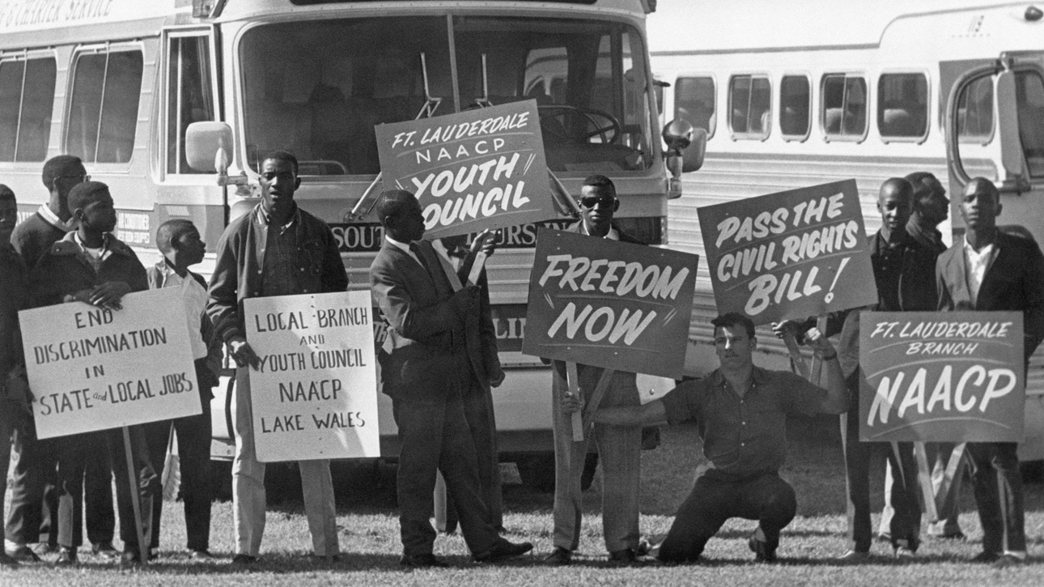
The Niagara Movement
The Movement
The Place
The Result
  July 5 1905 The Niagara Movement had its first meeting set by Du Bois
  29 members came together to discuss the missions of the movement
  Set to be held in Buffalo NY, the meeting was moved for safety concerns as no establishment would willing host them
  The meeting was held at Bertie Hotel in Fort Erie
Not long after the 29 men had their foundational meeting at the Bertie Hotel, the second meeting encouraged women to join the movement
MANDY TAYLOR USSRF
Notes:
The Niagara movement aimed to further African Americans’ fight for civil rights following the American Emancipation Proclamation of 1863.
The meeting that took place at the Bertie hotel was when the 29 men from fourteen states met to write the group’s founding principles.
The second meeting encouraged women to join the movement. By 1907 half of the delegates were women
The Niagara movement did not make as much headway as Du Bois would have liked. Rebranding shortly after to the now worldly recognized NAACP (National Association for the Advancement of Coloured People)

Slide 7
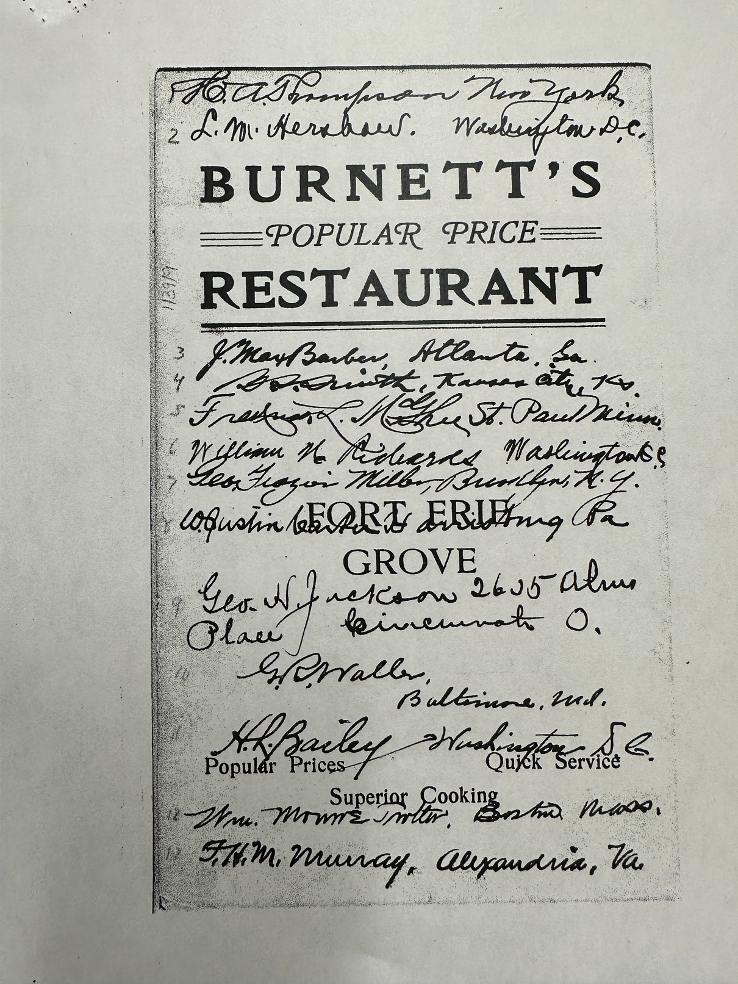
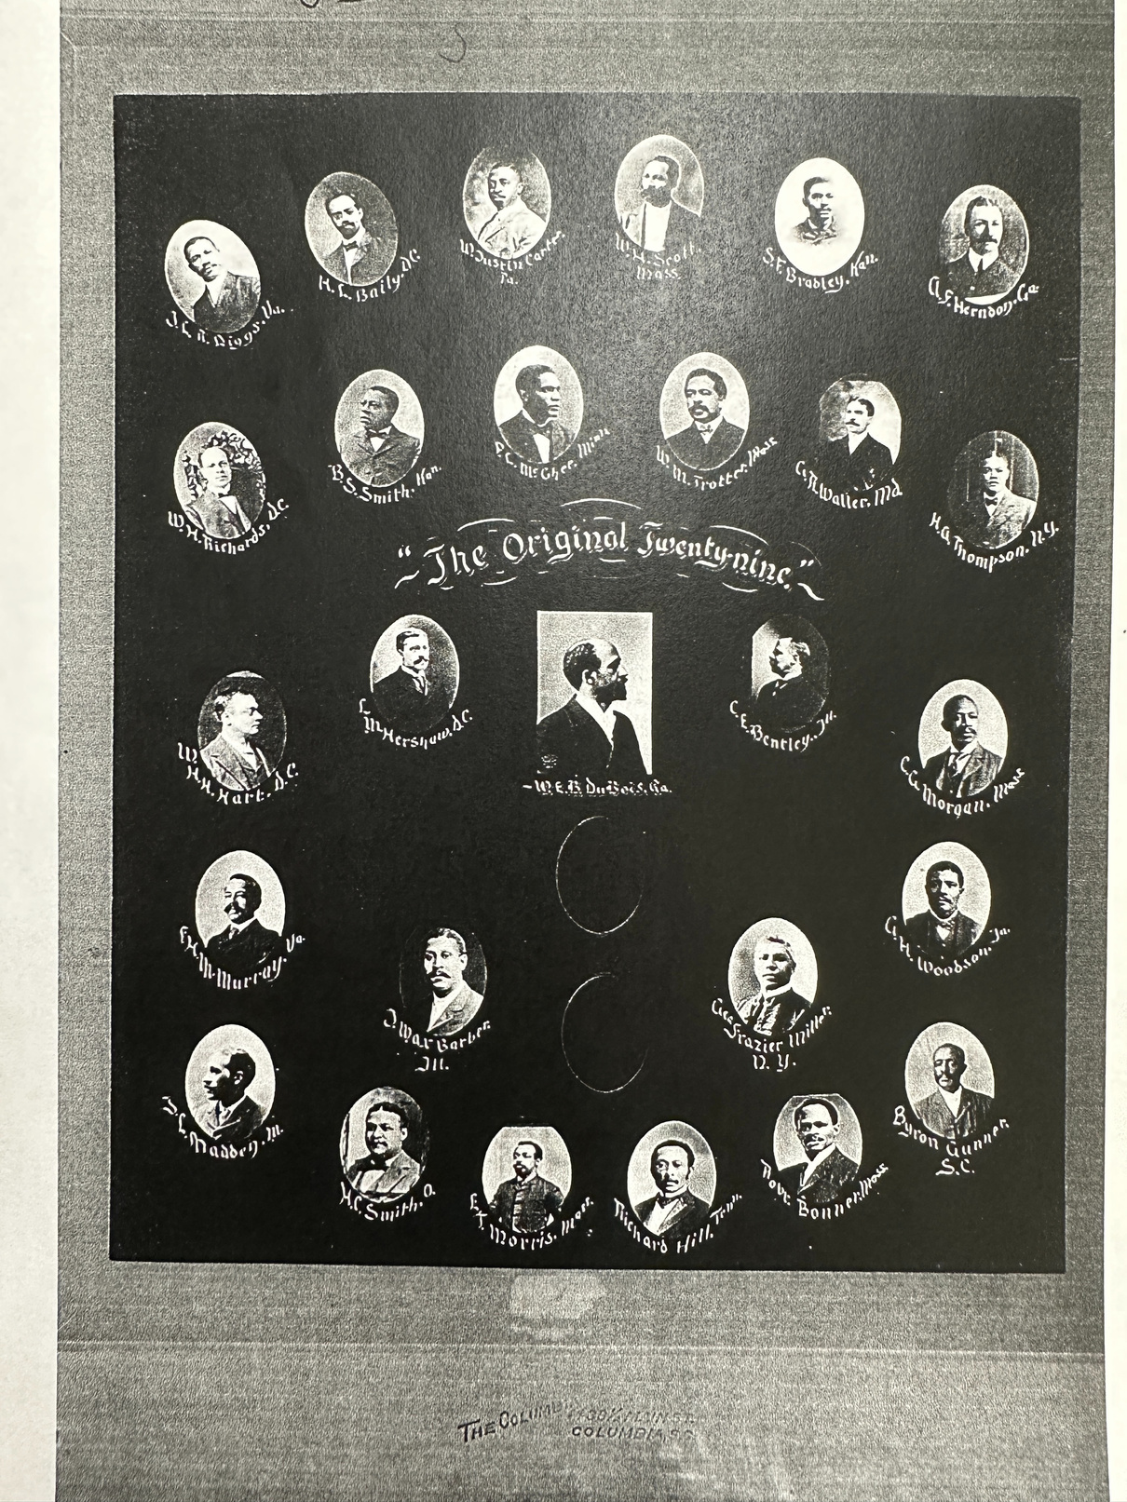
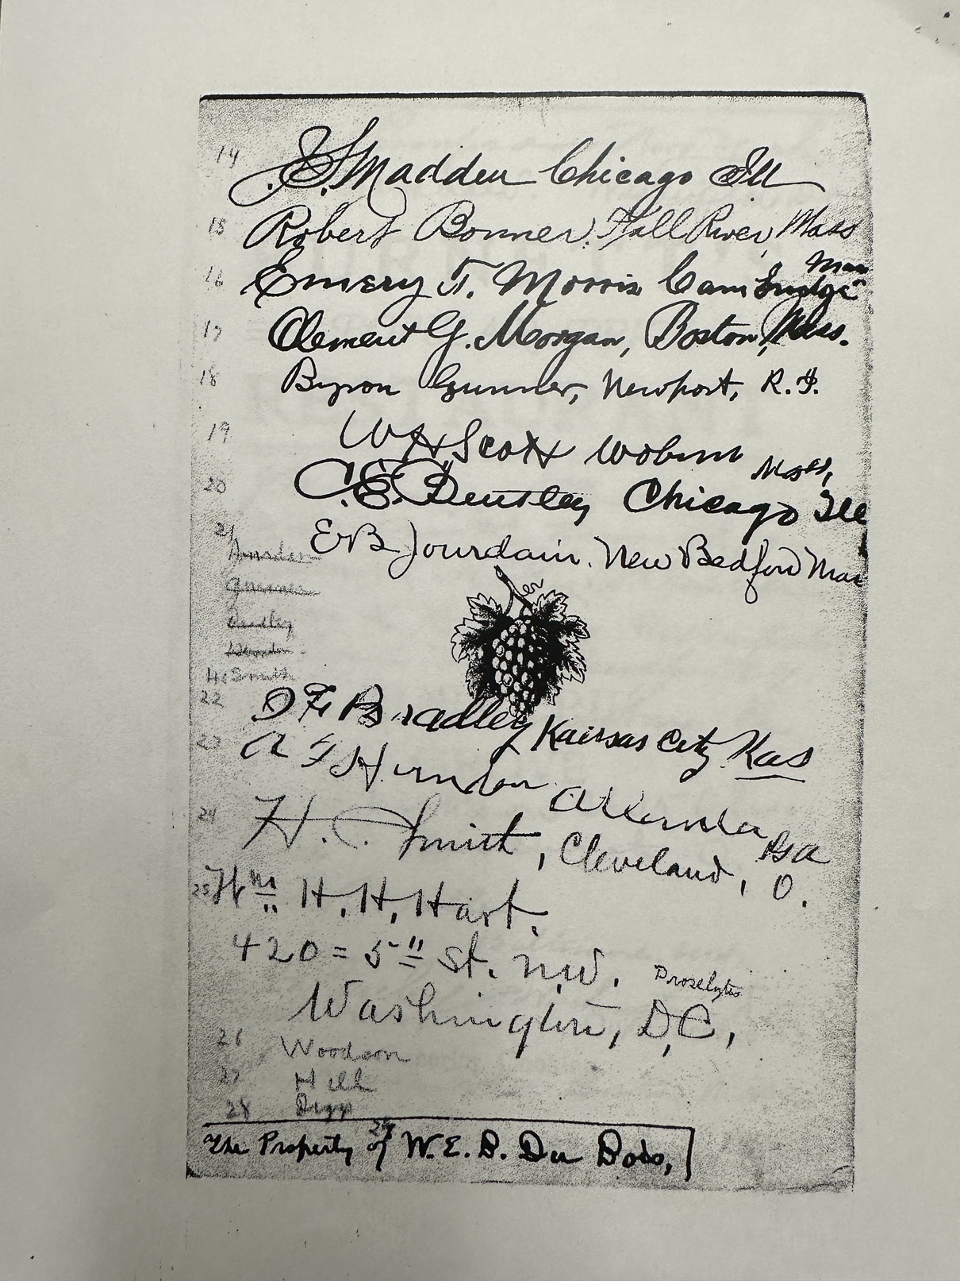
MANDY TAYLOR USSRF
Notes:
The 29 men signed a menu at their first meeting in Fort Erie

Slide 8

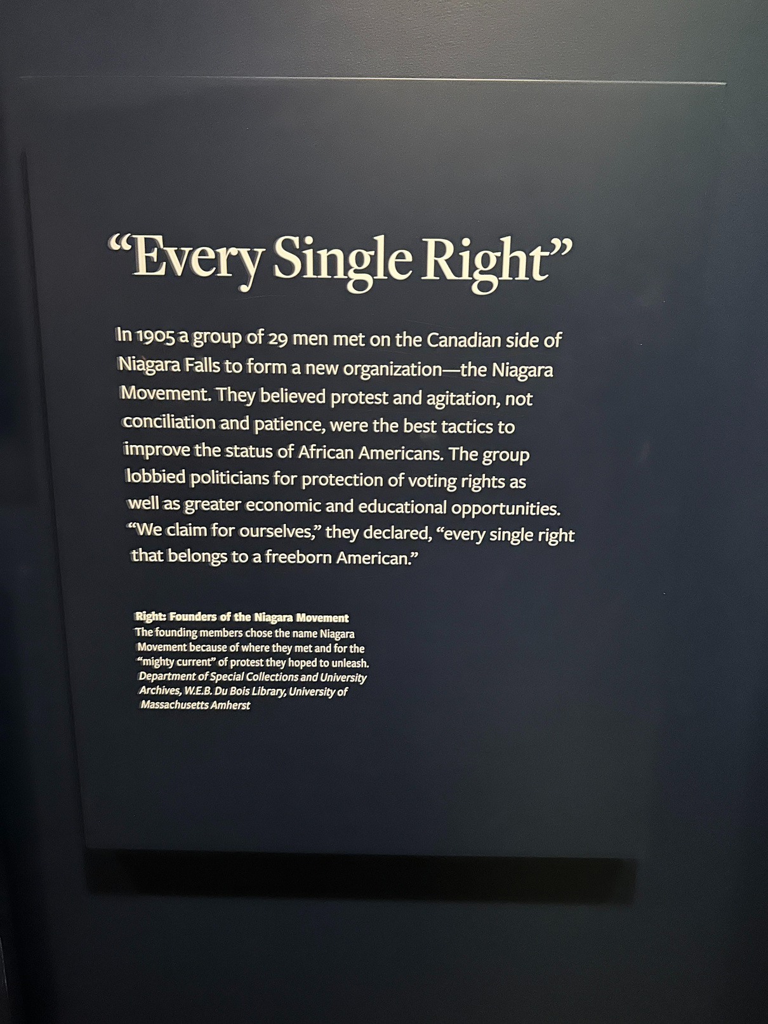
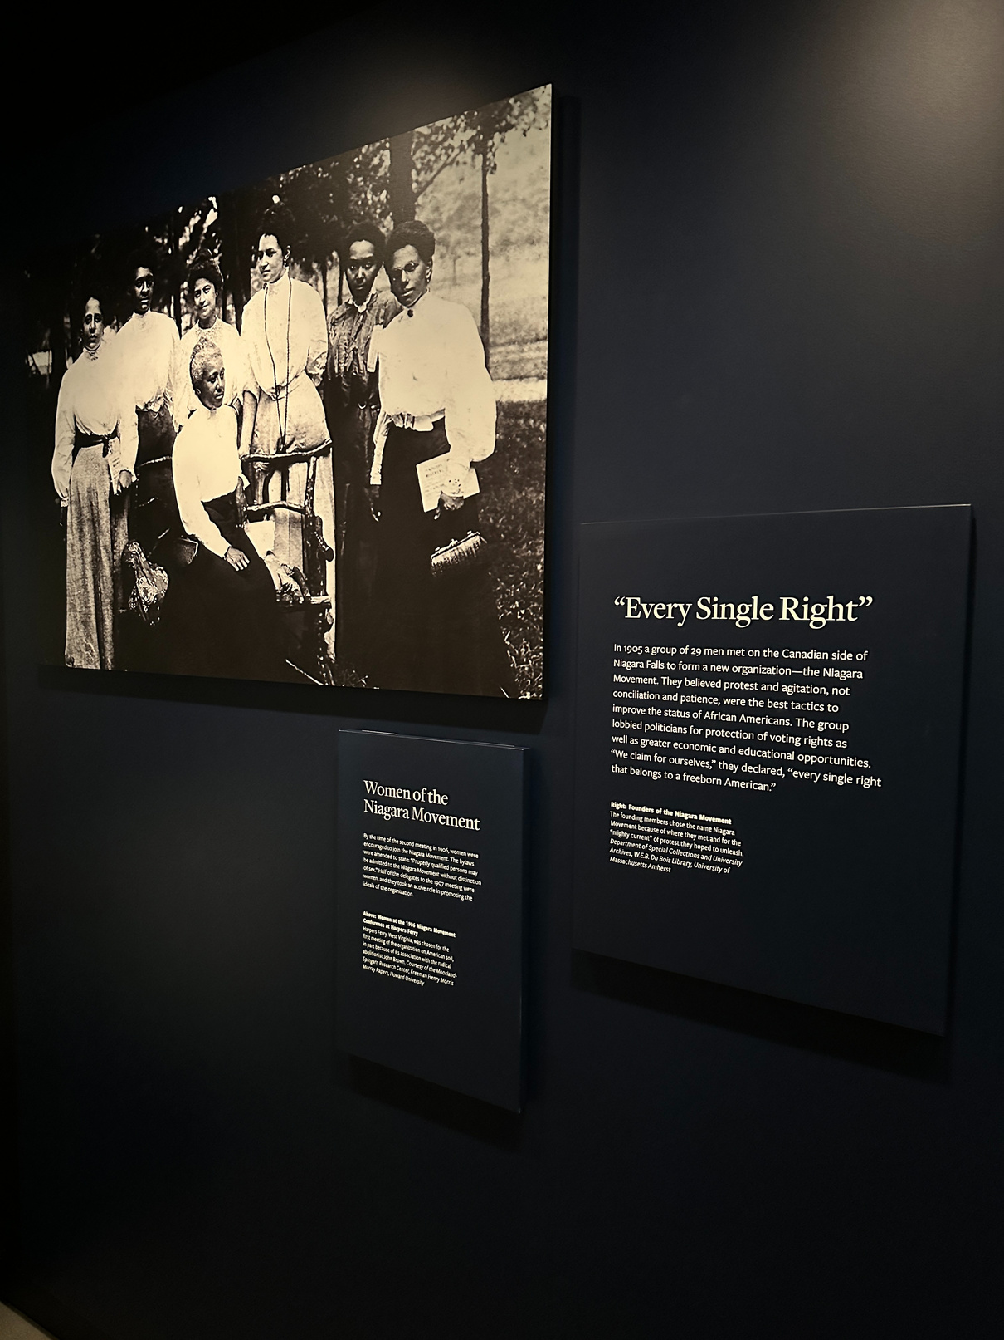
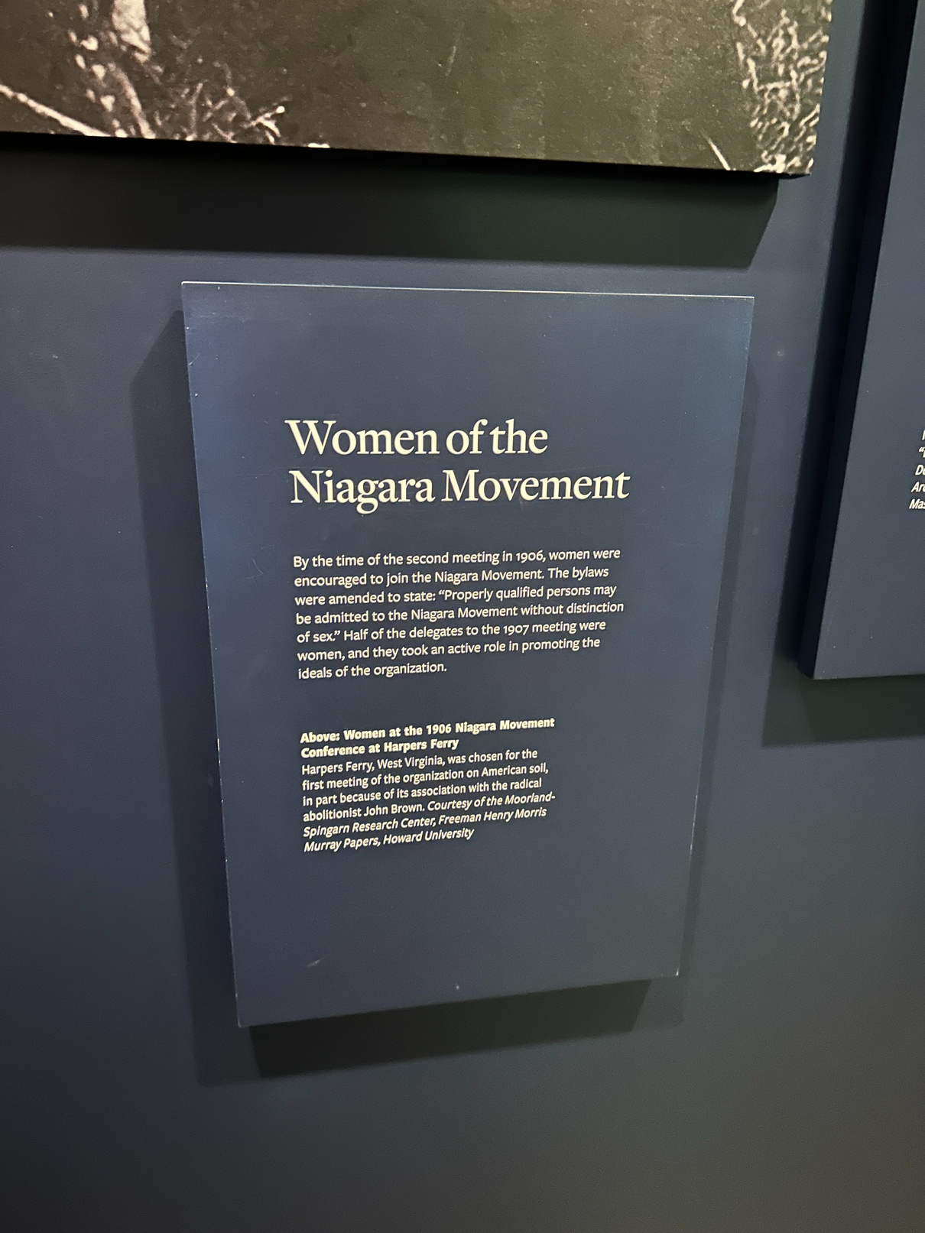

MANDY TAYLOR USSRF
Notes:
Photos taken by Mandy Taylor at the African American Museum in Washington DC.

Slide 9
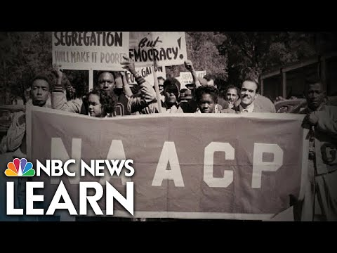
NAACP
Purpose
  Advancement of Coloured People
  Equality for all through civil rights
  To end segregation, discrimination and the barriers to achieve life, liberty, and the pursuit of happiness
MANDY TAYLOR USSRF
Notes:
The purpose of the NAACP was really in simple terms a movement for equality and equity for coloured people. To achieve the life of man set out in the constitution, to achieve the liberties that were the foundation principles for American.

Slide 10
War & Civil Conflict
Coloured Troops
1812-1814
Crystal Beach Riot
All over Canada starting notably with the American Revolutionary war Black Soldiers fought for our nation.
  Colored Corps.
  Captain Runchey's Coprs of Color
  Those untold
  Found freedom and went on to defend their freedom on the front lines
  Defenders from near and far In the fight of Fort Erie
  1956 Memorial Day & racial tension
  "absolutely intent to injure and maim any colored person in sight"
  "confronting the physical manifestation of black migration"
MANDY TAYLOR USSRF
Notes:
During the American revolutionary war Black troops fought on the British side that settled upper Canada in 1783. These black loyalists continued to fight during the war of 1812, and the rebellion of 1837. (Niagara Falls review)
The exact amount of Blacks who fought in these wars are not exactly clear as records were not properly kept, or kept at all. However we do know Black loyalists were on the front lines with mentions of the colored corps and Runchey's Corps of Color in the Niagara region. Unfortunately due to bad record keeping and the exclusion of the vital efforts made by Black soldiers, we are still today identifying and learning of the untold stories of the Black heroes on the front lines. (Runchey)
The war of 1812 - 1815 relied on Black soldiers on both sides. Blacks fought for the US and British Upper Canada.
The now free Black Canadians were quick to join the fight to defend Upper Canada against US invasion as they did not want to see the American principles including slavery ravage the freedoms of Canada. (Black Canadians and the war of 1812-1814)
During the war of 1812, Blacks from all across Canada came to border towns such as Fort Erie to fight off the Americans. Including John Baker who was originally from New Brunswick who fought in Niagara Falls, Chippawa and Fort Erie.

