Slide 1


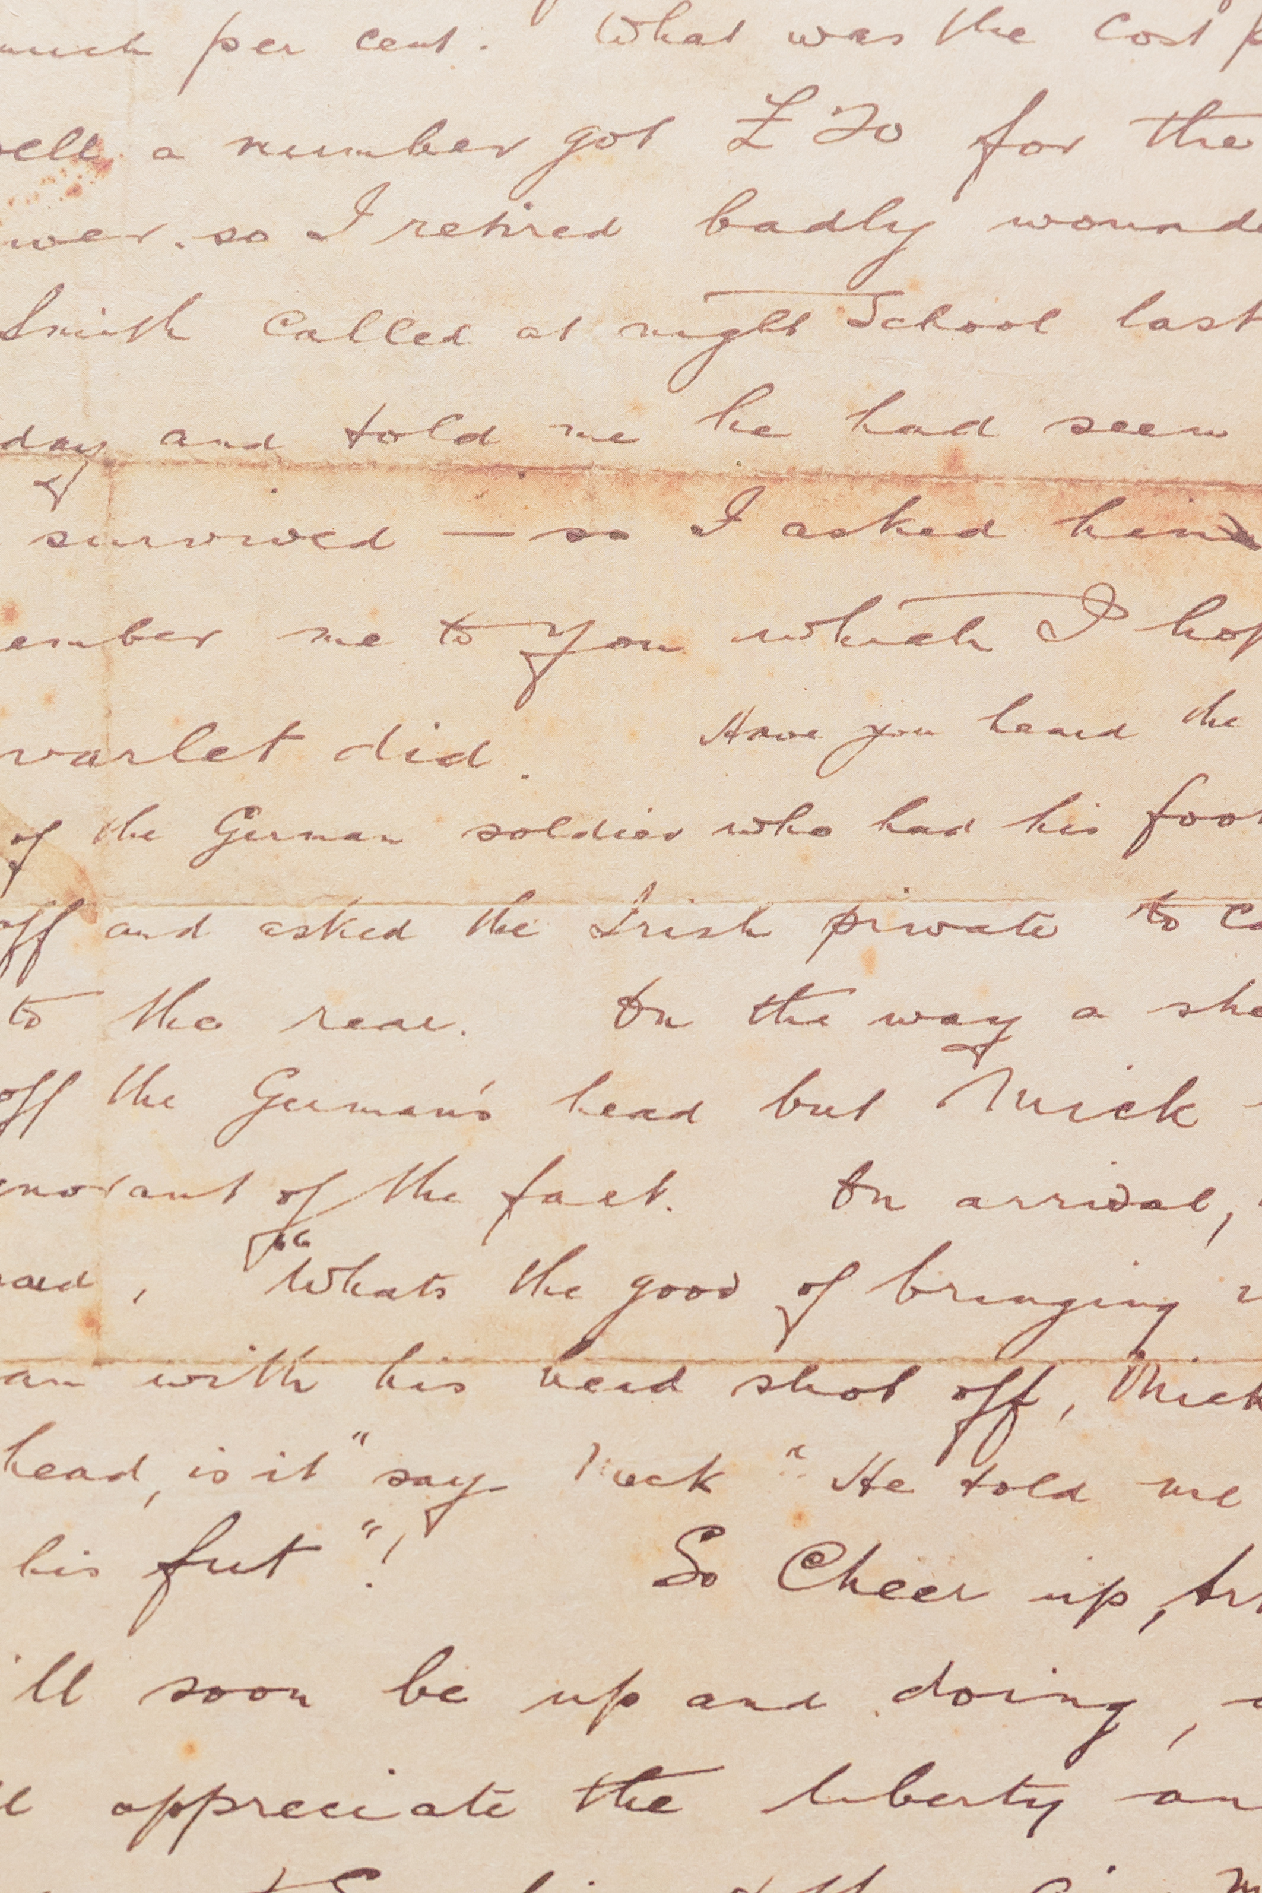

Localizing Black History
AN INTRODUCTION TO THE FORT ERIE & GREATER BUFFALO - NIAGARA REGION'S BLACK HISTORY
By Mandy Taylor
FUNDED BY QUEEN'S UNIVERSITY USSRF

Slide 2


Table of Contents
01
02
03
WHAT IS BLACK HISTORY?
FORT ERIE:
PEOPLE & PLACES
A SHARED HISTORY
FORT ERIE & BUFFALO
04
05
NIAGARA REGION & MODERN BLACK HISTORY
SITE TOUR
MANDY TAYLOR USSRF
Notes:
During this week of discovery we will be first taking a look at a brief overview of Canadian Black history, and touching on a bit of what localized history looks like.
Day two will be a deep dive into our local history discovering the untold stories of our past local Black residents.
Day three will delve into the shared history between Buffalo and Fort Erie, and how two countries divided by a border allowed for the freedom of those enslaved.
Day four will take a look at Black history in our more broad region.
Day 5 will end with a tour, of all of the local places in Fort Erie that we discussed in day two, as well as finish with a two page written reflection assignment of what you learned throughout this week, and what you hope to learn more about in future.

Slide 3



AWARENESS QUIZ
5 MINUTES
MANDY TAYLOR USSRF
Notes:
This quiz is not for marks, it is to grasp where students Black History awareness is before starting the lesson.
Quiz available in appendix file

Slide 4
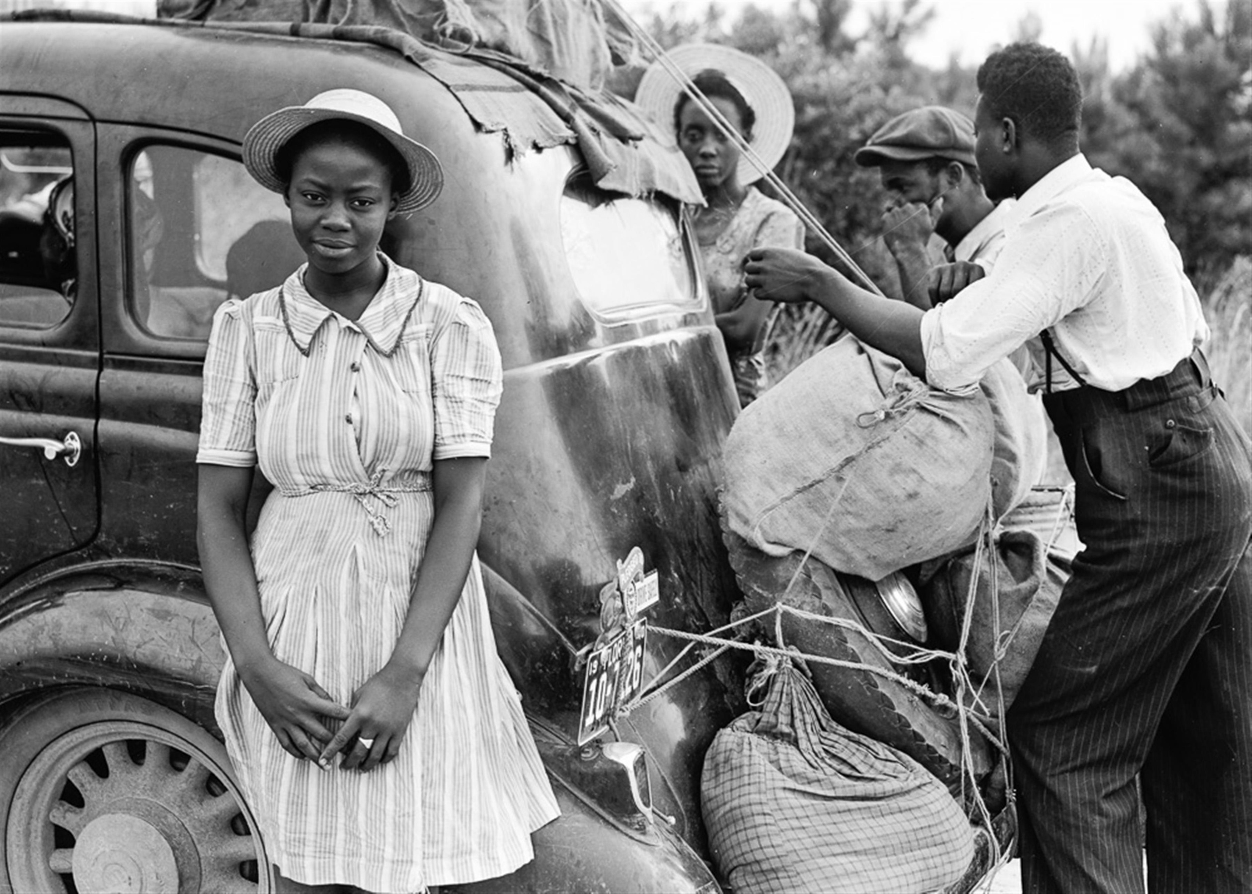
BLACK HISTORY
What do you think of when you hear "Black History?"
Guiding Questions:
If you close your eyes and think of Black History what do you see?
Does the term make you feel anything? I.e, proud, sad, confused?
Why Is It separate?
MANDY TAYLOR USSRF
Notes:
Using a chalk / white board, or chart paper the teacher will write "Black History" and have students come up with words or phrases they associate when thinking of "Black History"
Post word-map discussion lesson talking points:
Establish a definition of what black history is.
- Black history, is the detailed recounting of the lives, stories, trials and tribulations of Africans who landed on North American soil. We will be taking a look at Black Canadian and shared Black American histories.
Where it is / why it exists.
- Everywhere, Black history is really just history, as all human history starts in Africa. Black History, is its own entity now due colonialism, the transatlantic slave trade, and who was the first to record the published history that was easily accessible to the world.

Slide 5
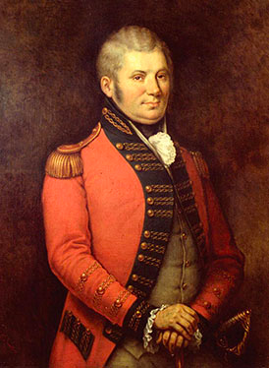
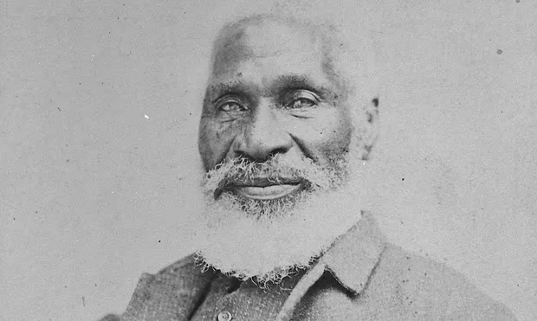
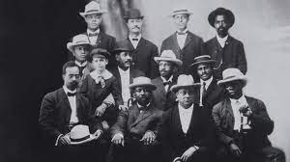

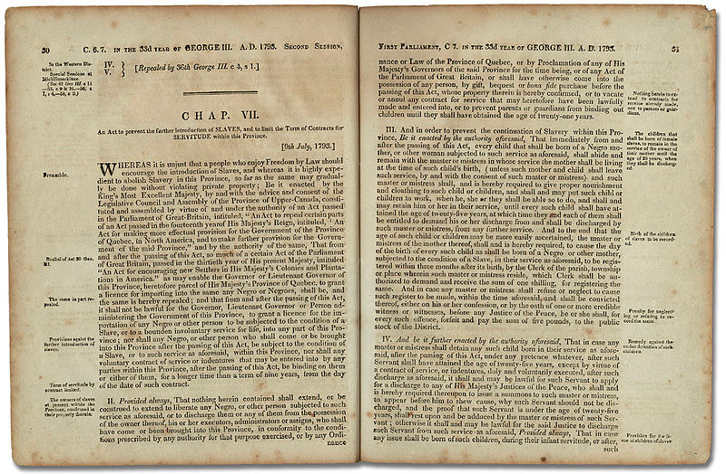
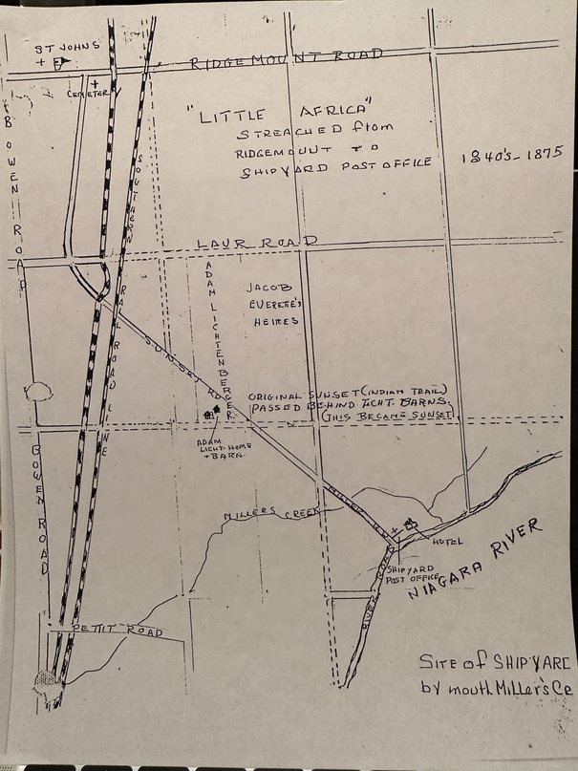
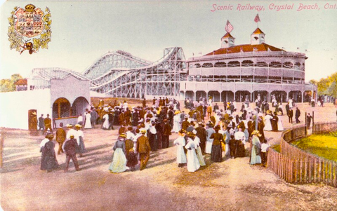
Timeline
1830 - 1880
1830 -
1880
1793
1956
Act Against Slavery
Little Africa
The Crystal Beach Riot
Chloe Clooney & John Simcoe
Josiah Henson
The Niagara Movement / NAACP
Black Movements
1792
1905
2020
1792
1830
1905
2020
MANDY TAYLOR USSRF
Notes:
Here is a timeline of important topics that we will be discussing over the course of this week.
We begin in 1793 to more presently 2020, seeing where Black history really began in Canada, and where / what it looks like and means today.

Slide 6



Introduction
Let's start at the beginning, the beginning of Canada, and our area.
Videos:
https://www.canada.ca/en/canadian-heritage/campaigns/black-history-month/transcript-proud-history.html
https://www.youtube.com/watch?v=obVdj6PtWtA
Reading for this module:
  "Simcoe wanted Canada to Mirror England"
MANDY TAYLOR USSRF
Notes:
Watch videos first then go into reading reading notes on next slide

Slide 7
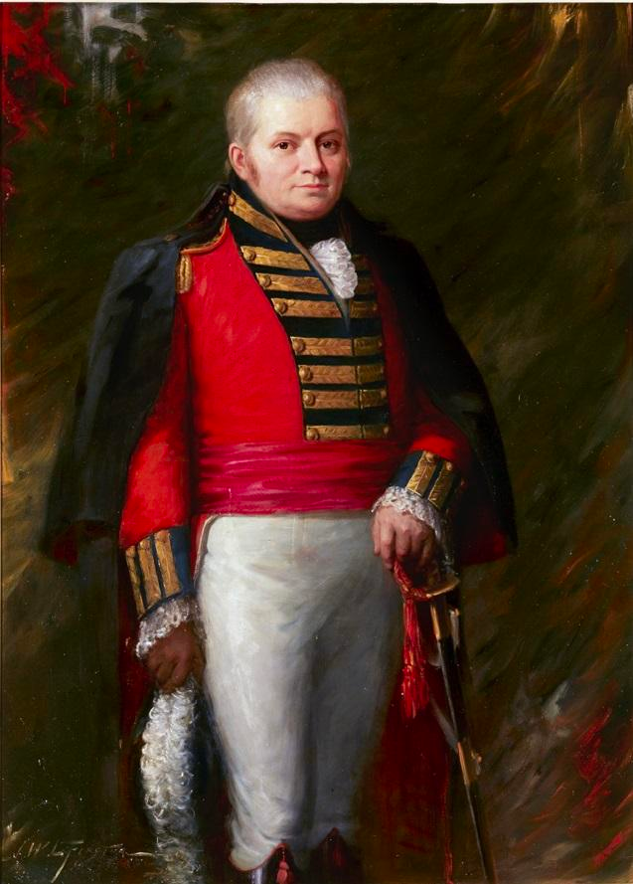
Simcoe & Cooley
JOHN GRAVES SIMCOE
John Graves Simcoe
  Presided over Canada’s first parliament and wanted upper Canada to be a miniature England.
  Believed and fought to abolish slavery In Canada "The Slave Bill"
  Was met with opposition yet achieved a compromise for Canadian slavery
CHLOE COOLEY
Chloe Cooley
  Cooley was first enslaved by Benjamin Hardison of Bertie Township (now Fort Erie, Ontario) before being sold to Adam Vrooman
  She was said to Inspire Simcoe to further push for the abolishment of slavery In Canada (Henry, 2013)
MANDY TAYLOR USSRF
Notes:
Teacher to read article to students. Be sure to cover these main talking points from reading:
- John Graves Simcoe presided over Canada’s first parliament.
- Wanted upper Canada to be a miniature England.
- While Simcoe wanted Canada to mirror England he was very progressive in his policy pushing for the abolishment of slavery in upper Canada.
- This proposition was met with great oppression; however, Simcoe held strong on his belief and came to a compromise that no new slaves were to be brought into the province, and existing slaves must be freed within 9 years. Additionally, children of slaves were freed at the age of 25.
- Due to Simcoe’s strong will slavery in the province gradually disappeared. A few short year later following the lead of Denmark, upper Canada became the first British colony to strike down the slave trade all together in 1973
* Talk a bit about Chloe Clooney here *

Slide 8
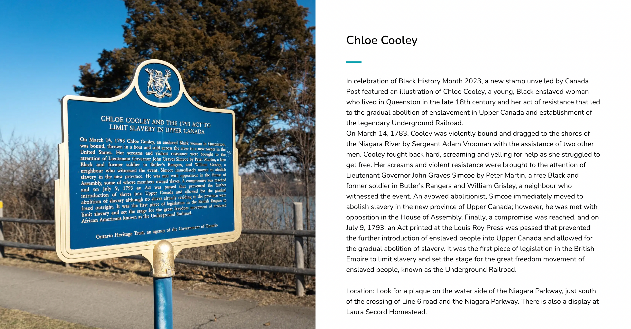
MANDY TAYLOR USSRF
Notes:
Have students silent read from the slide. Handout available in appendix for TA to use for IEP students.

Slide 9
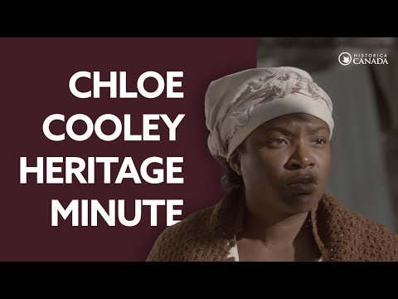

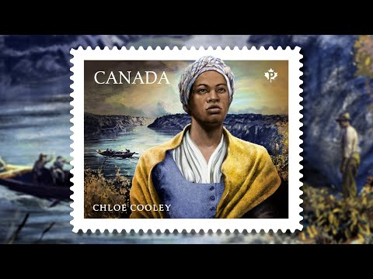
MANDY TAYLOR USSRF
Notes:
Play heritage minute video first followed by the Canada post video

Slide 10


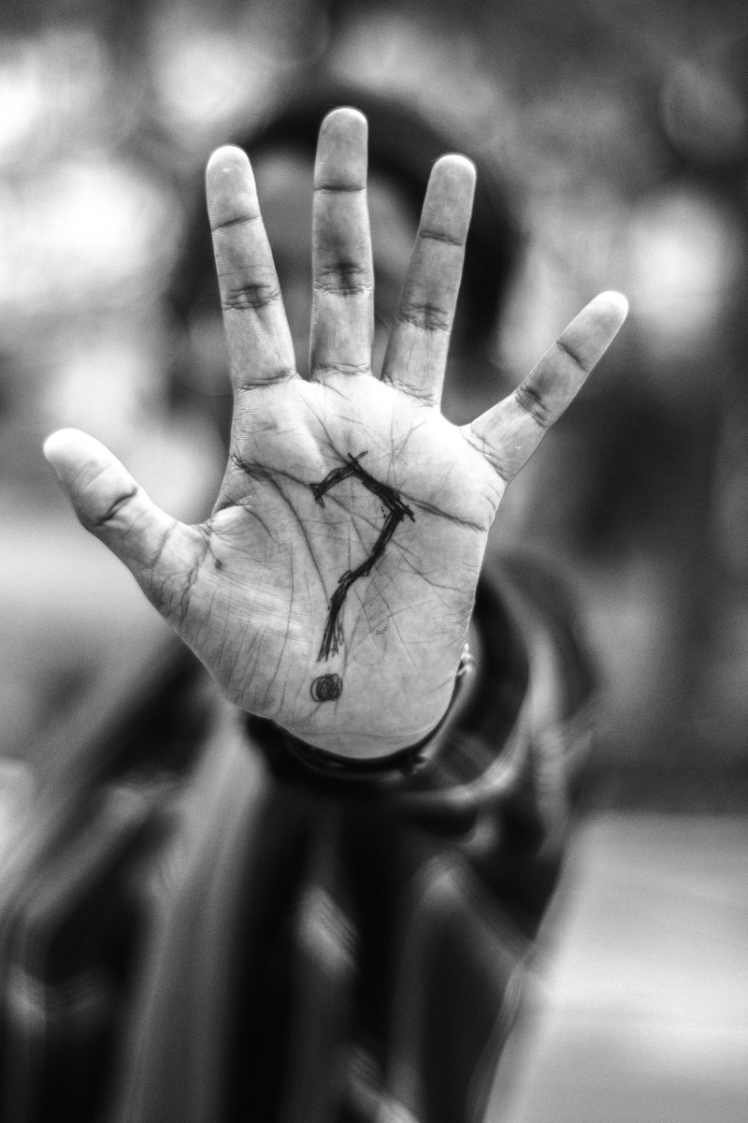
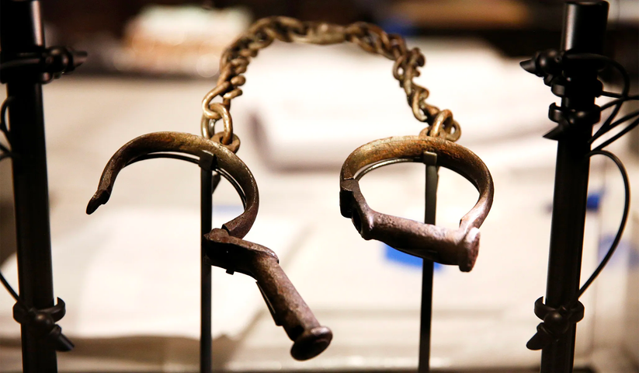
Day 1 Review
Homework:
Read Tiffany Mayer article
"Museum holds evidence of slavery in Niagara"
Answer these questions:
1.) What did Ford mean when they said
“I don’t like to call it denial. I just think it's been omitted.
You have to look at who wrote the history of Canada”
2.) Why do you think as Ford put it that Black history is not part of Canada’s mainstream history?
3.) Why do you think slavery wasn’t as widespread in Canada as it was in the U.S?
What new ideas did you notice from the videos that were not included in the word map?
What do you think happened to Chloe Cooley?
How do you think Chloe Cooley paved the way for the abolishment of slavery in Canada?
MANDY TAYLOR USSRF

