Slide 1



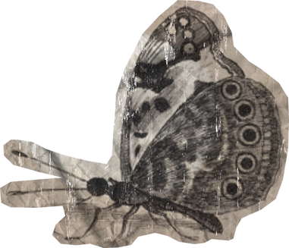

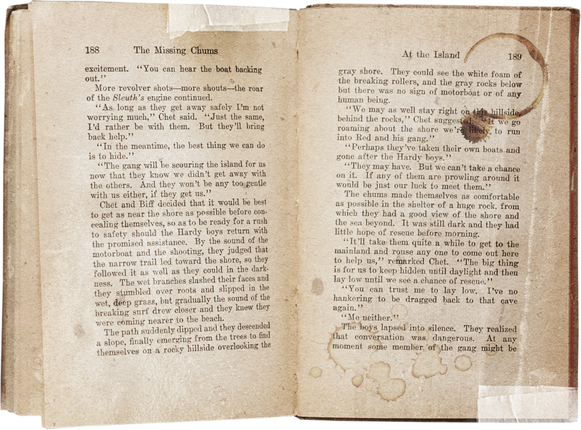
MODERN
Black History
MANDY TAYLOR USSRF

Slide 2

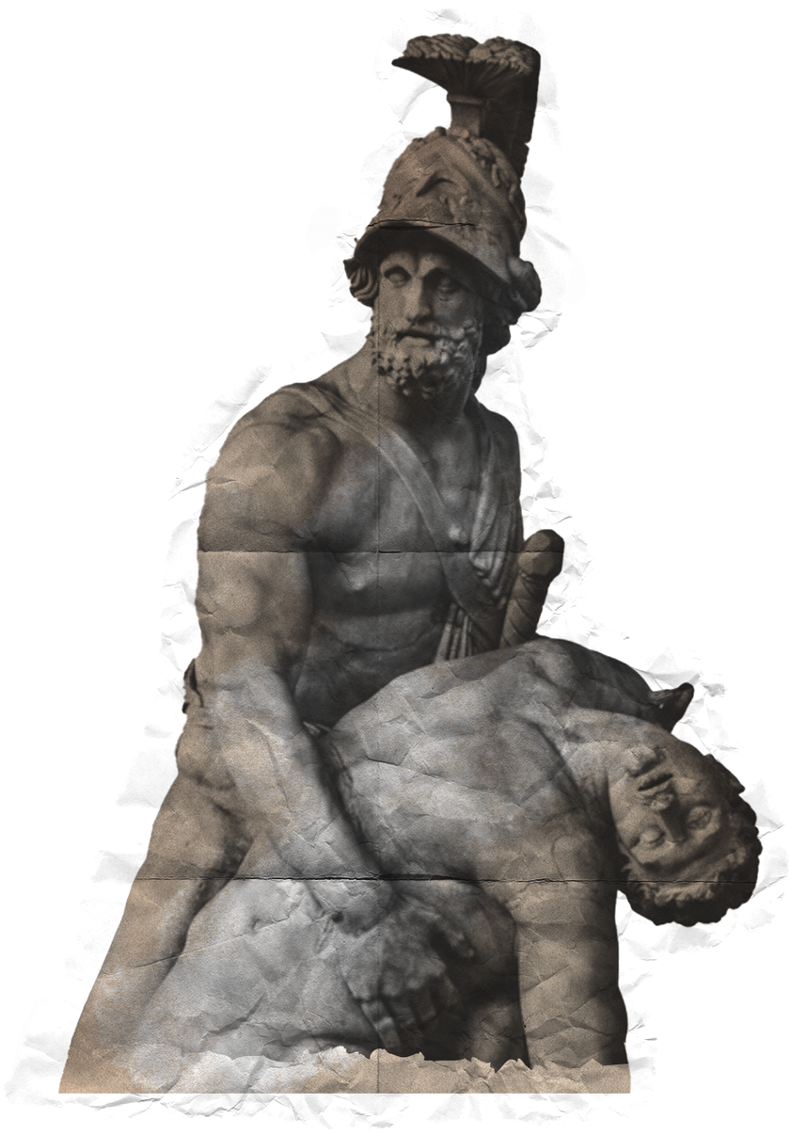

How can we honour the past and safeguard the future?
01
04
Buffalo
Black Lives Matter
02
05
Homework Presentations
St. Catharines
03
Niagara on the Lake
MANDY TAYLOR USSRF
Notes:
Today we will be covering areas outside of Fort Erie in the region, as well as a few modern stories / events of Black history

Slide 3
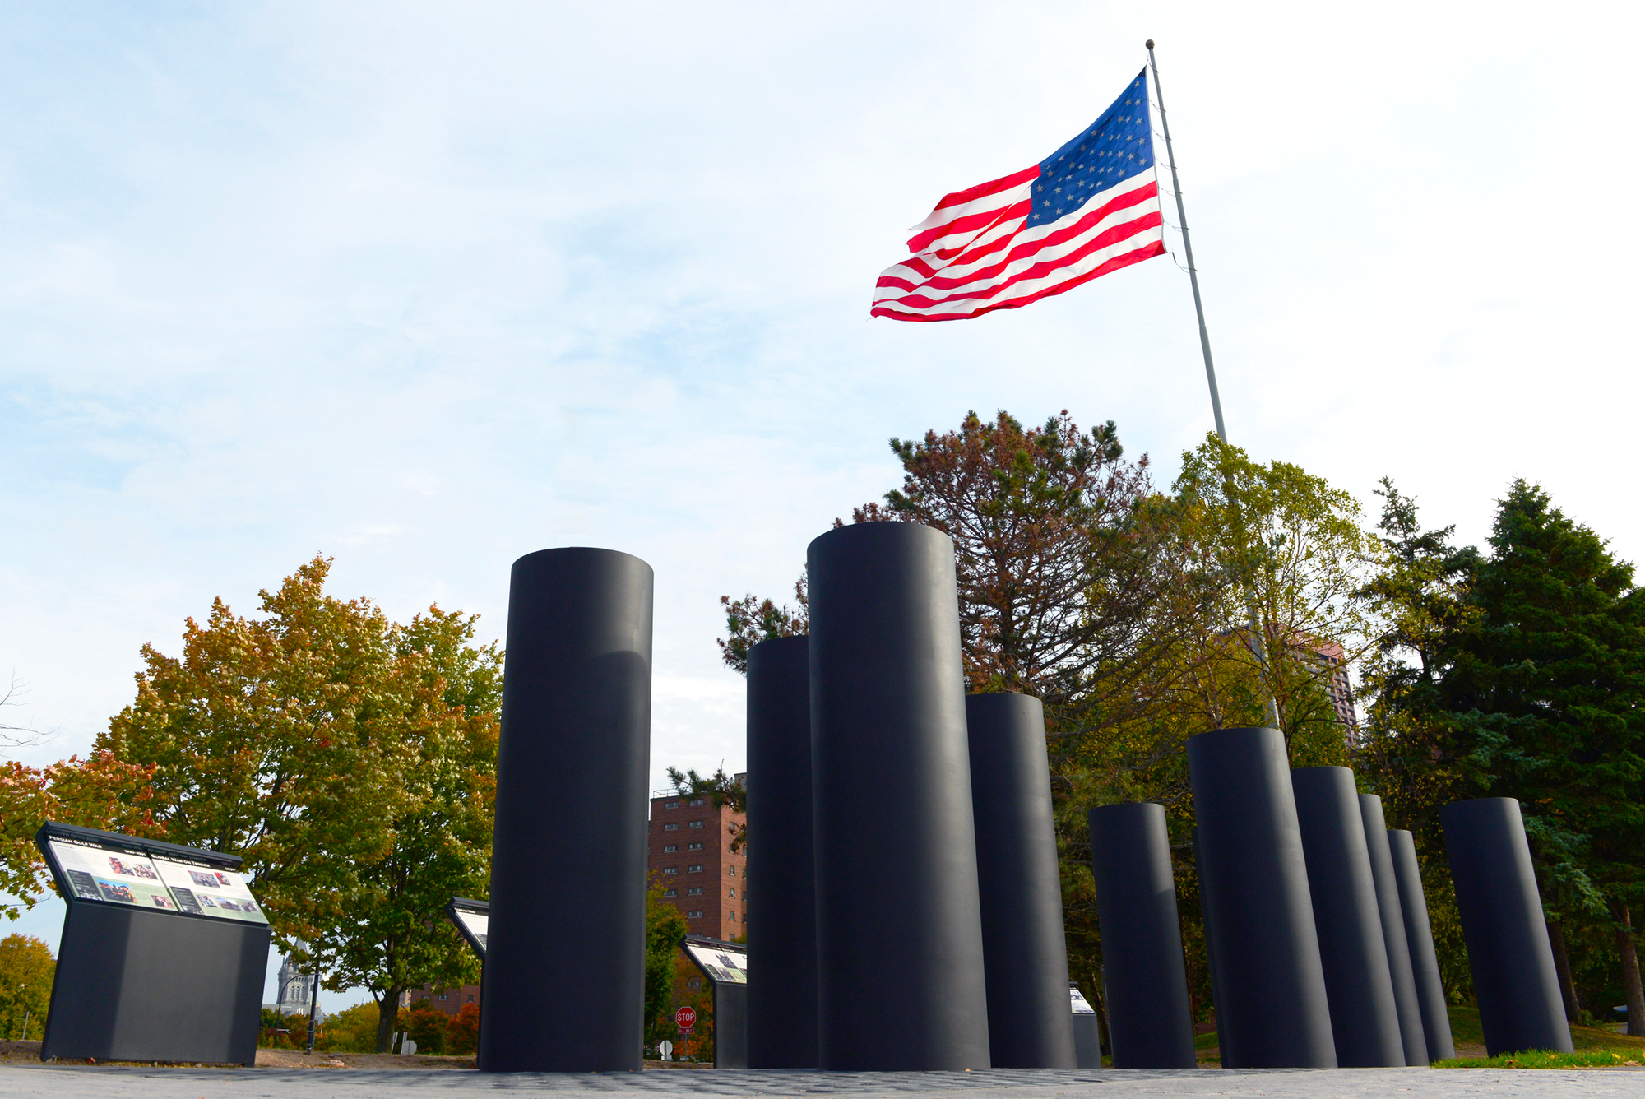
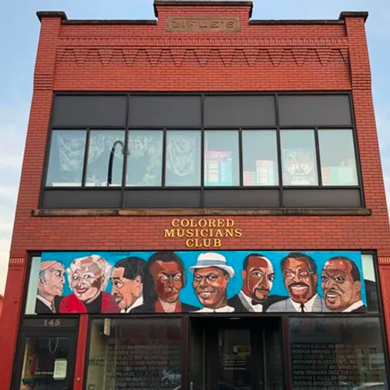


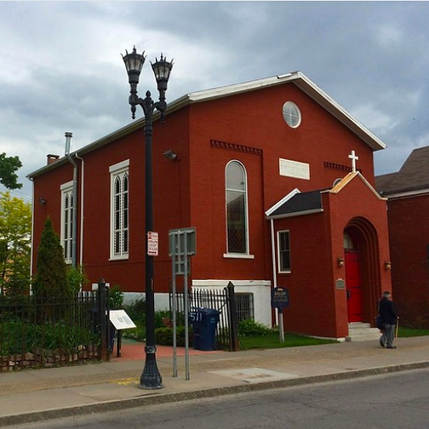
Buffalo
Colored Musicians Club
  Starting as local 43 and turned into the club
  In 1934 the 533 union acquired the club to allow musicians to hangout after their shows
  Musicians wore suits to make a performance special even when playing for friends and family
  The Queen City & the African American Corridor
  Michigan Street Church
  Coloured Musicians Club
  African American Veterans Monument
Michigan Street Church
  Famously used by the Stafford family during the fugitive slave act era
  A bounty hunter found them In Canada and brought them back to the US
  The congregation got the best of the bounty hunter and got the family back to St. Catherine's.
MANDY TAYLOR USSRF
Notes:
The colored musicians club like churches were places for Blacks to dress up as they usually only worked uniformed jobs. This is why we see in the club and at churches the "Sunday Best"
- George Scott, president of the colored musicians club
Currently the club is undergoing renovations and is set to reopen in 2024
Play video "CMC Jazz Museum video"
The African American Veterans monument (background photo) play this video before the video embedded in the slide
https://aavmwny.org/the-monument/

Slide 4


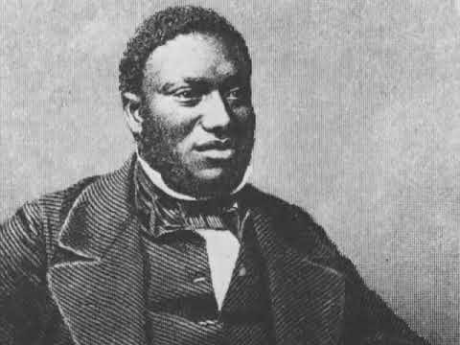
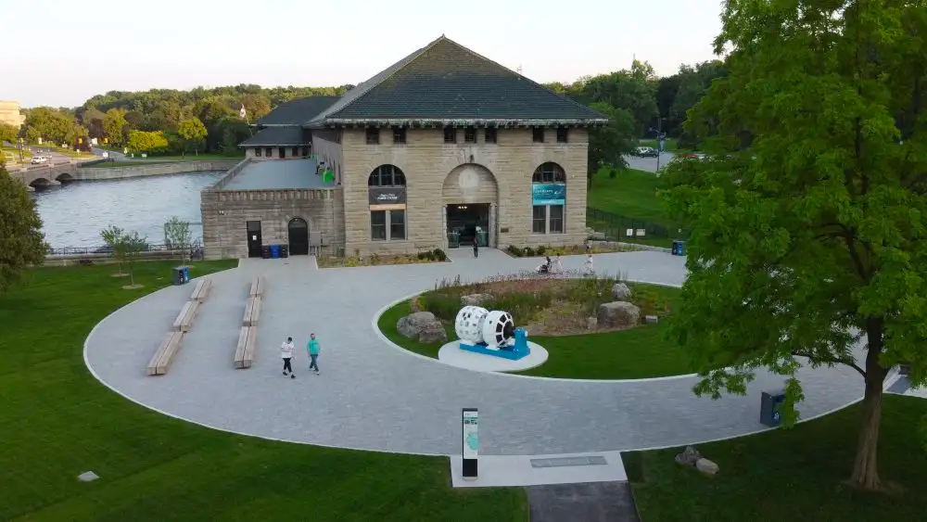
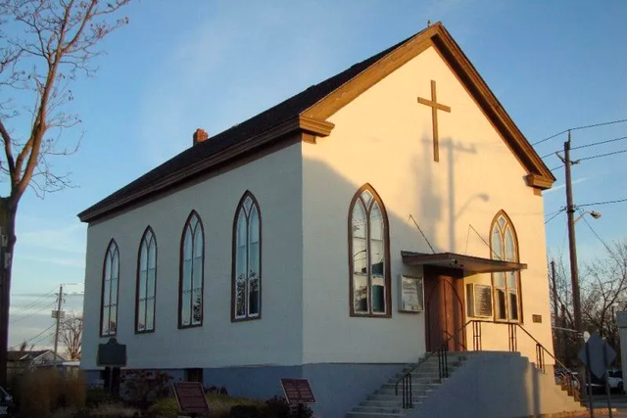

Niagara Falls / St. Catharines
St. Catharines
Salem Church
Niagara Parks Power Station
MANDY TAYLOR USSRF
Notes:
Niagara Power Station
On April 25, 1902 John Clark, a Black employee, went to work his regular night shift.
As a nipper (someone who prepares dynamite) he went to grab a few pieces and noticed that wires had been tampered with.
Had he not found this tampering, the dynamite would have detonated and 17 workers would have lost their lives.
St. Catherines
* Play video *
Salem Church
Alike many other freed Black slaves Harriet Tubman spent quite sometime in Canada, calling St. Catharines home for many years. The Salem Church otherwise known as the Harriet Tubman church still stands in St. Catharines today and is now a designated historical landmark.

Slide 5


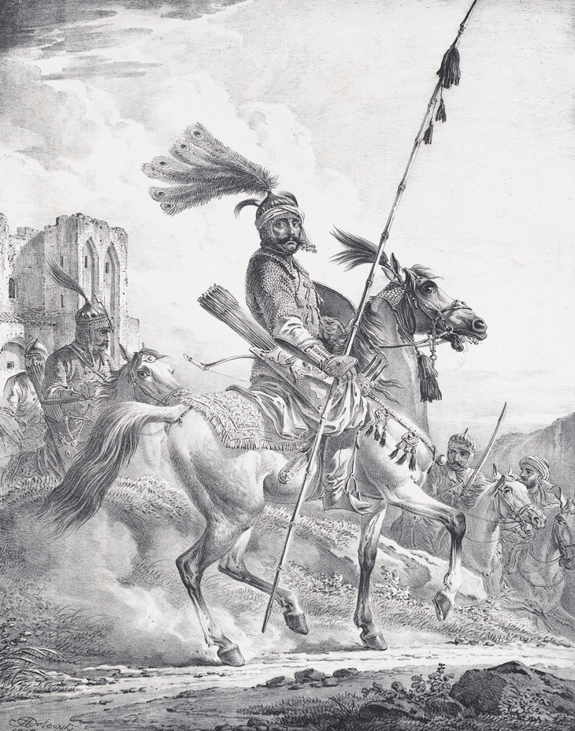
Niagara on the Lake
The Voice of Freedom Park
  Commissioned in 2014 with its grand opening in 2018, the Voices of Freedom park was made to commemorate the 225th anniversary of the Slave Bill brought to fruition thanks to John Simcoe.
  The park's goal to provide an accurate and complete story telling of history. The park is like a living book where those visiting can go on a self-guided walking tour journey, listening to some of the Black stories that passed through NOTL. Some notable stories that we have touched on such as Chloe Cooley and the Black Colored Corps.
MANDY TAYLOR USSRF

Slide 6

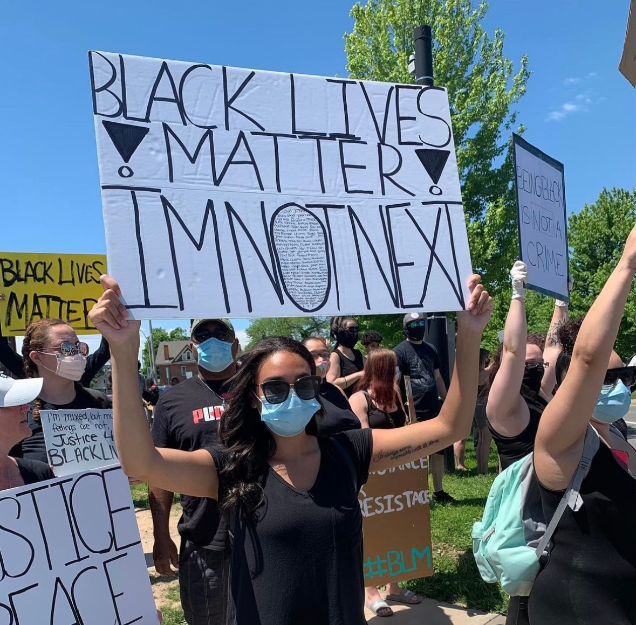
BLM & Black Movements
Black Lives Matter
  A saying that made a movement
  Founded to fight the acquittal of Trayvon Martins Murderer
  Reached a peak in 2020 with death of George Floyd, Breonna Taylor, and Ahmaud Arbery
  Faced controversy when its founders were found to be using donated founds for personal use
Justice for Black Lives
  A grassroots organization founded right here in Niagara falls by Sherri Darlene
  Not associated with the BLM movement
  Fighting for justice, promoting equity, and creating a space for belonging and Identity for local Niagara Black people.
MANDY TAYLOR USSRF
Notes:
Mandy Taylor creator of this 5 day lesson plan is pictured holding up a sign at the justice for black lives protest in Niagara Falls Ontario in 2020

Slide 7

Homework Presentations
MANDY TAYLOR USSRF

Slide 8

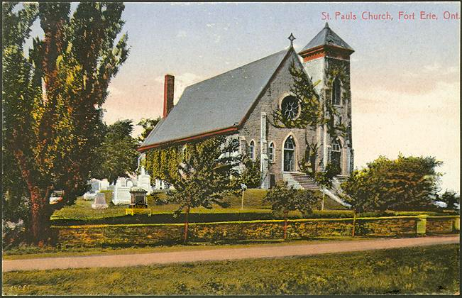

Day 5
  Bus tour of Fort Erie sites
  Lunch
  Bring:
    Sunscreen
    Camera / phone for photos
    Comfortable shoes
    Sensible seasonal clothing
    Respectful and curious mindset
MANDY TAYLOR USSRF
Notes:
If students want to tour buffalo here is a resource for tour spots over there
https://buffaloresearch.com/ugrr/

Slide 9


Day 5 - Final Assignment
Over the past week we have explored local history, and discussed the importance of localizing Black History.
Write a two page reflection based on the following guidelines:
  How has your awareness of local Black history changed?
  How do you plan to continue to learn more about local Black History?
  What was most the most fascinating new piece of information that you learned?
  What are you excited to continue to explore?
  What would you have liked to learn more about during this week?
MANDY TAYLOR USSRF
Notes:
Fun series to recommend to encourage further education
https://www.primevideo.com/dp/amzn1.dv.gti.73a76084-575a-43fd-8f5f-ad569aee7b6e?autoplay=0&ref_=atv_cf_strg_wb

