Slide 1
Screws
Simple Machines

Slide 2
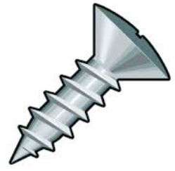
Screws are used to hold things together or to help lift heavy objects

Slide 3
What is a screw?
Click here to load video
on YouTube
Click here to load video
on mocomi.com

Slide 4
What is a screw?
Screw: a simple machine that is used to change circular motion into linear motion
As a screw twists, it is drawn forward

Slide 5
The head of a screw is twisted, spinning the threads and causing the screw to move forward
head
threads

Slide 6
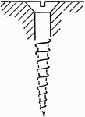
The threads move into an object, pulling it together with the screw
The rotation of the screw makes the shaft move forward further into the object
motion
force

Slide 7
What are some examples of screws you might see in your daily lives?

Slide 8
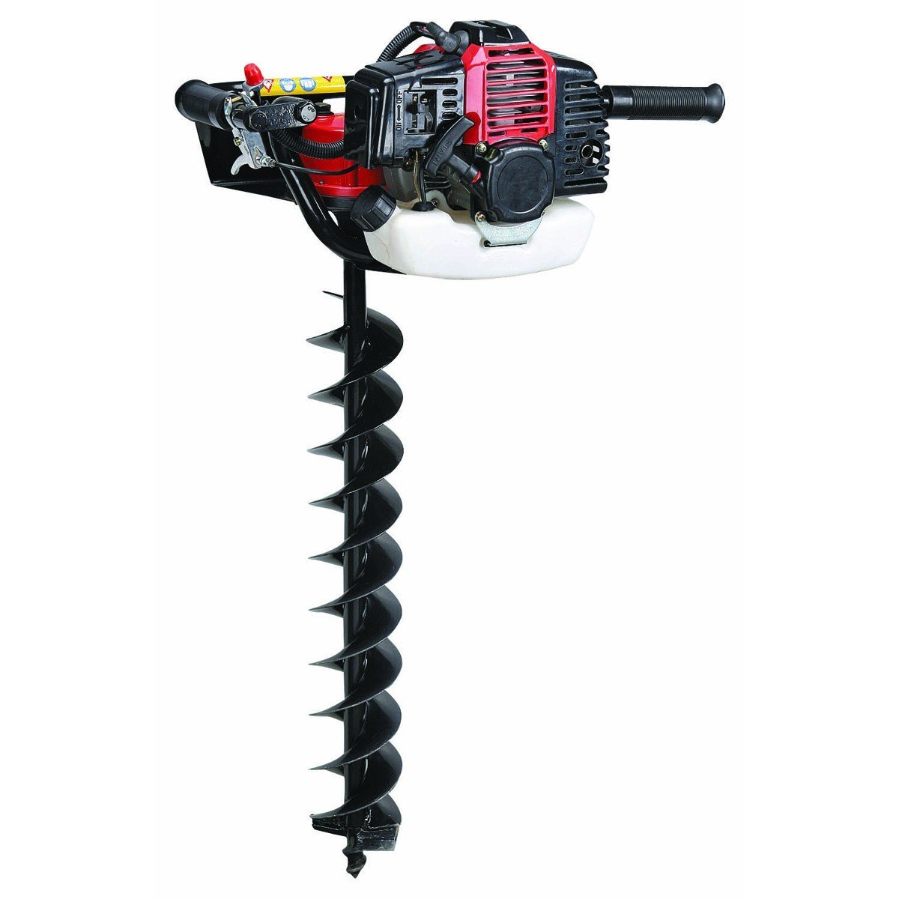
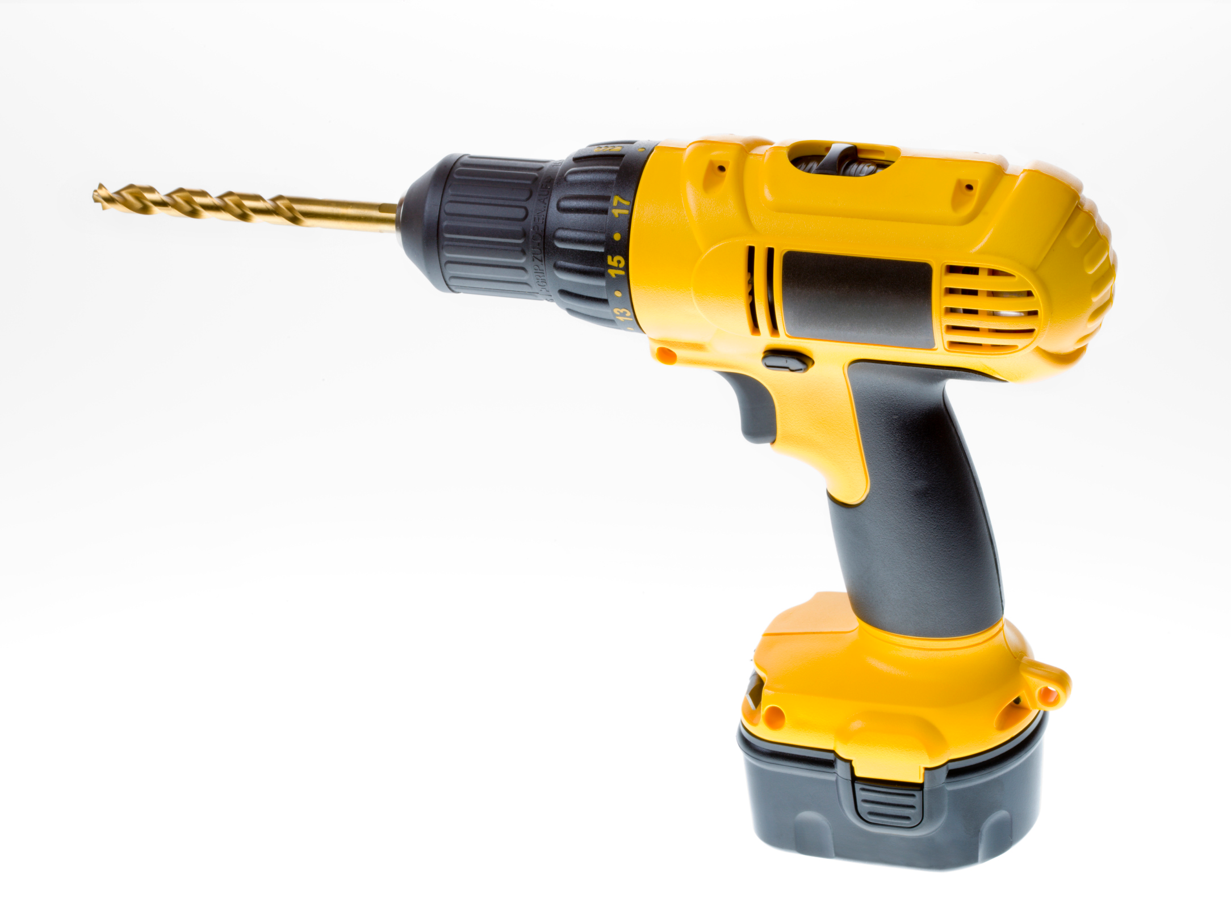
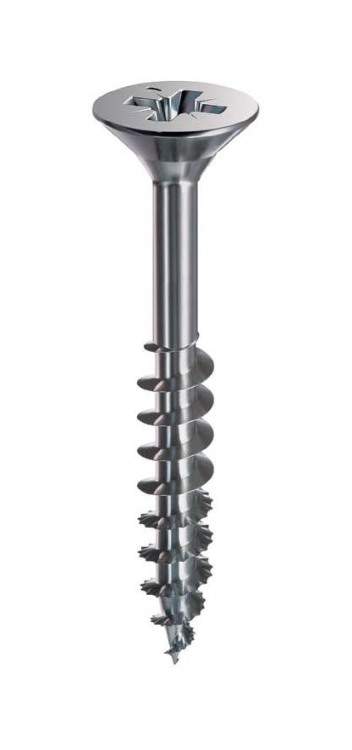
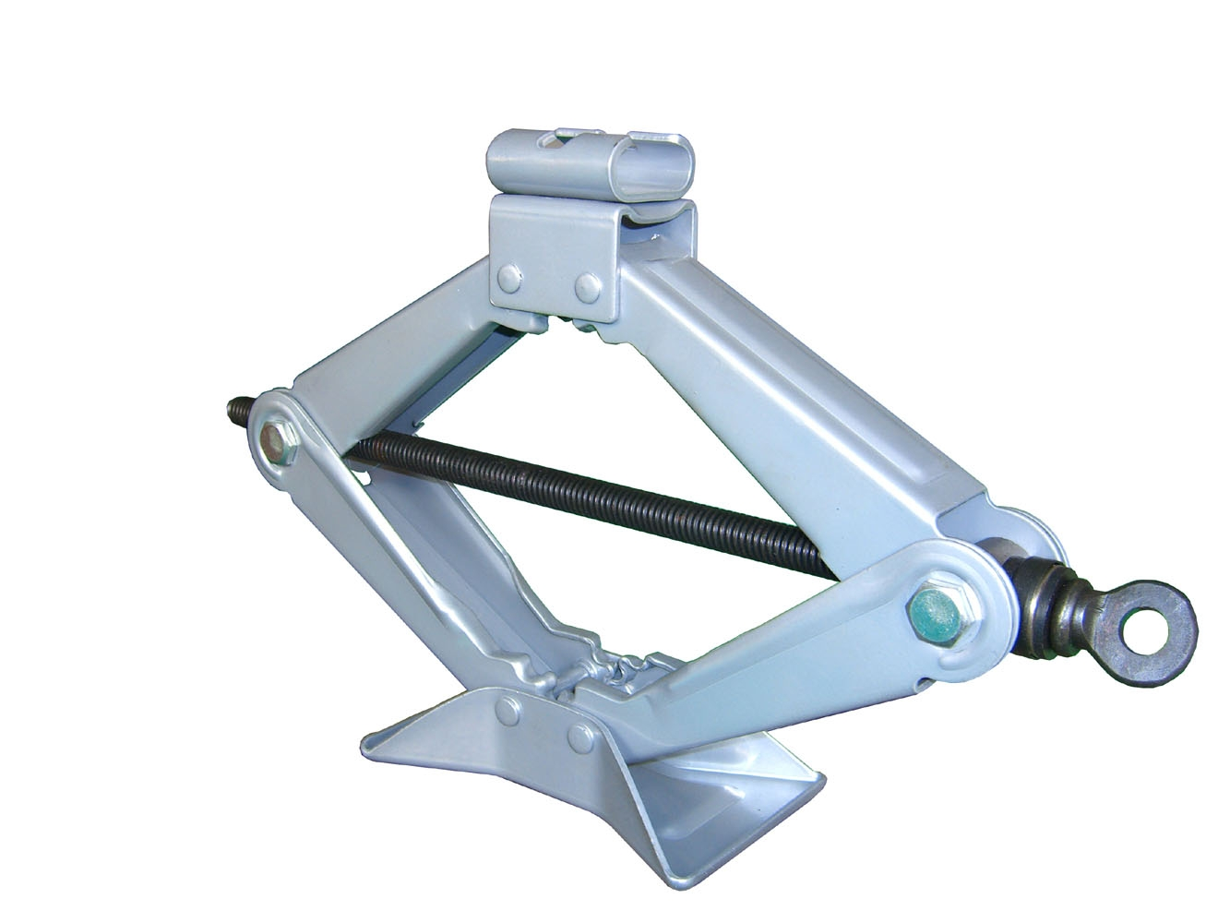
What are some examples of screws you might see in your daily lives?

Slide 9
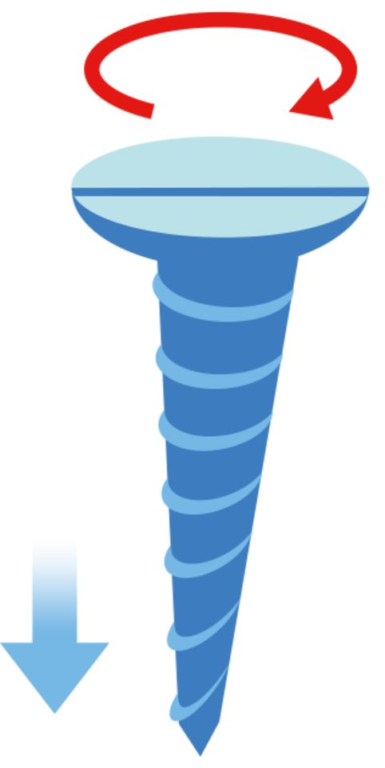
Screws are used when there is very little space to move objects around
Using a screw allows you to move something forward or backward using circular movement

Slide 10
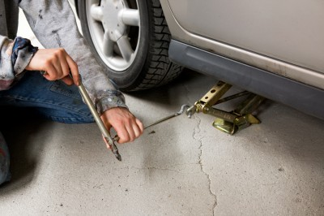
Screws allow you to apply force while the simple machine remains in place
Even in tight spaces, large amounts of force can be generated!

Slide 11
Types of Screws
Threads: the spiral part of a screw that wraps around the central cylinder
Wider and closer threads give more strength to every twist!

Slide 12
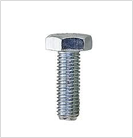
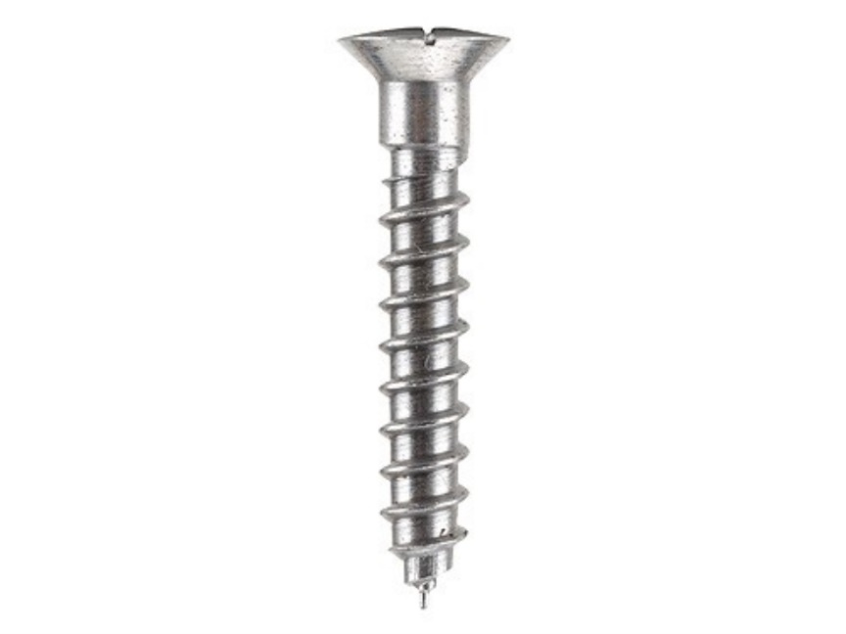
Types of Screws
large threads
small threads

Slide 13
Let’s try it!
Use different types of screws to move different weights!
Write down your observations

