Slide 1
Levers
Simple Machines

Slide 2
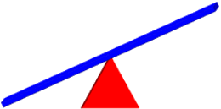
Levers are used to help lift heavy objects

Slide 3
What is a lever?
Click h`ere to load video
on YouTube
Click here to load video
on mocomi.com

Slide 4
What is a lever?
Lever: a simple machine that is used to change the direction of force needed to move an object over a fulcrum (pivot point)
The different kinds of levers depend on where the fulcrum is located

Slide 5
They work by using a strong beam that pivots at a point called the fulcrum
beam
fulcrum

Slide 6
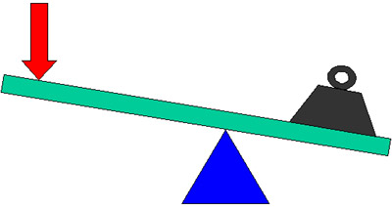
The beam spreads the weight of the object across a longer distance
The fulcrum is where the beam pivots, creating leverage, making it easier to lift objects on other side
load
force
beam
fulcrum

Slide 7
What are some examples of levers you might see in your daily lives?

Slide 8
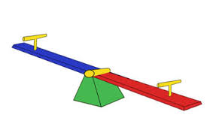
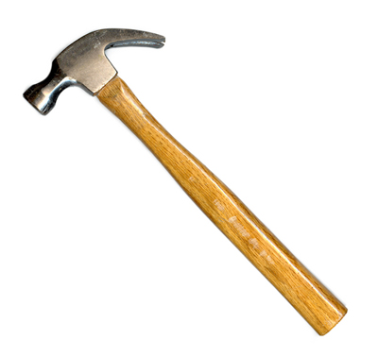
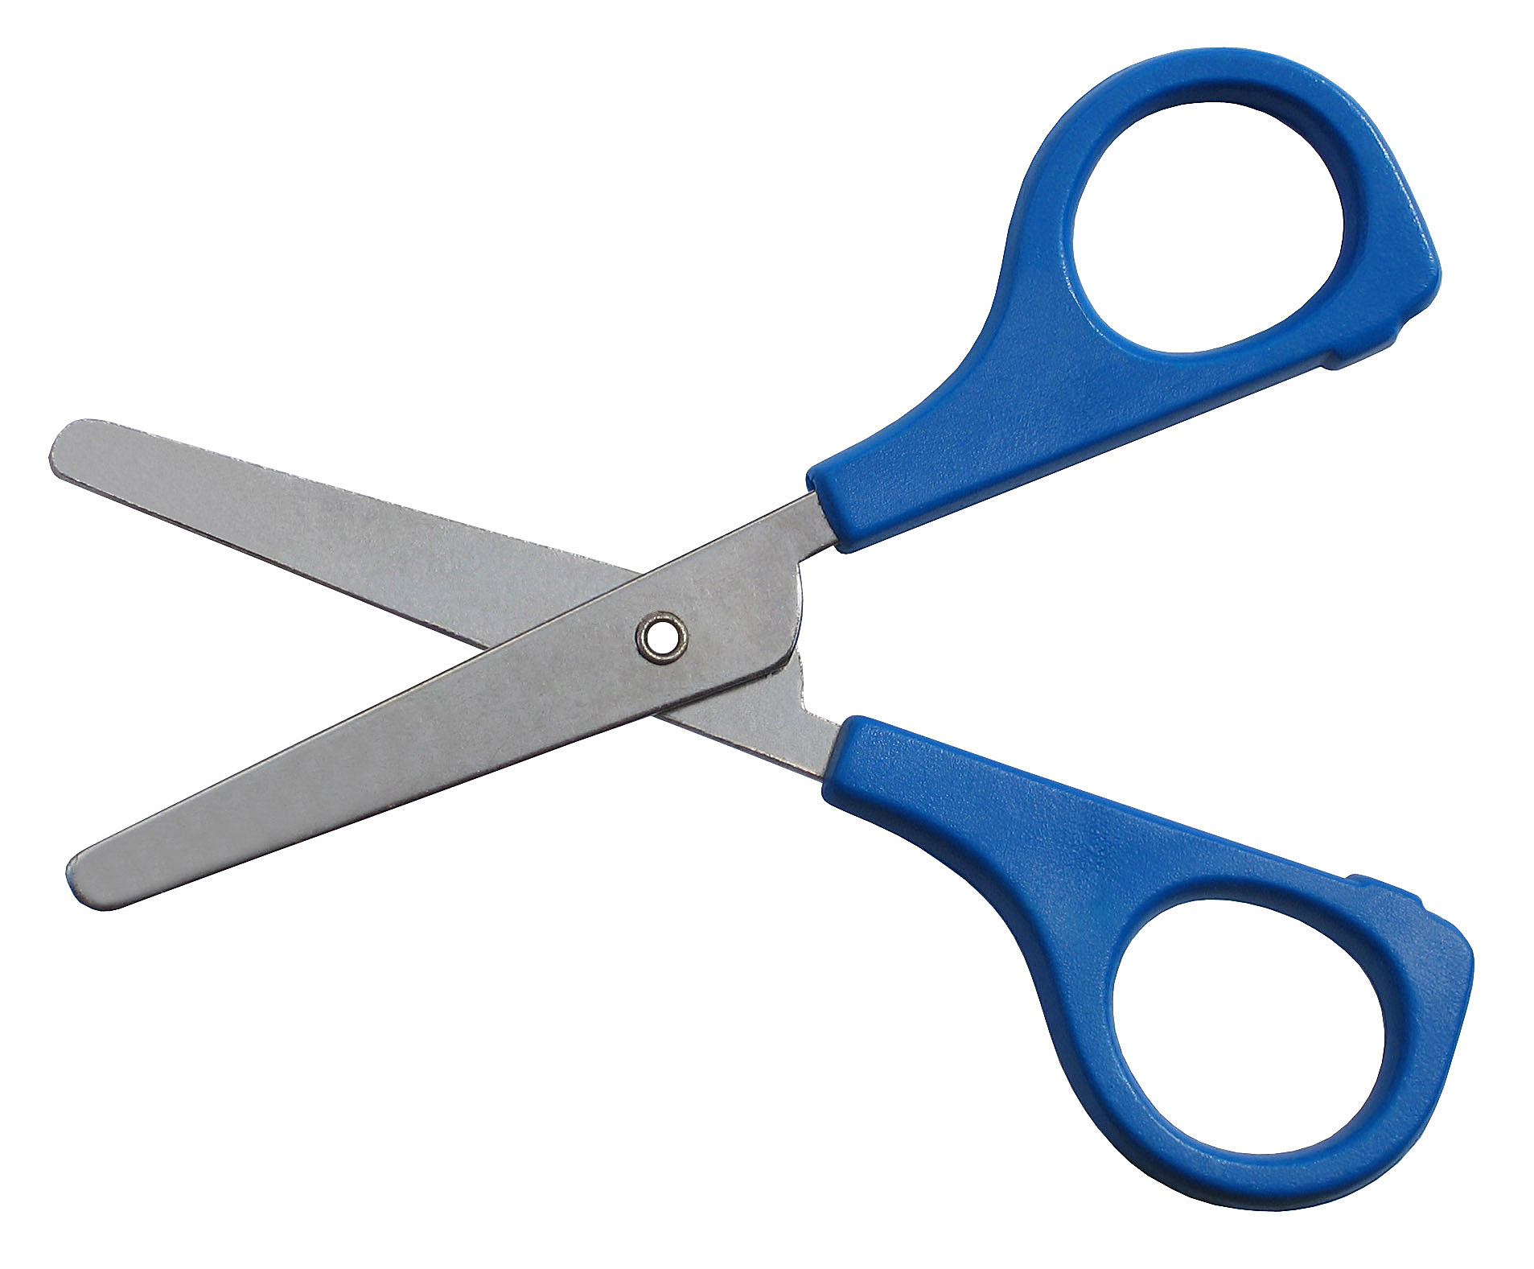
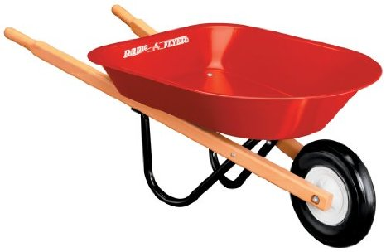
What are some examples of levers you might see in your daily lives?

Slide 9
Levers are used when objects are too heavy to pick up by hand
Using a lever allows you to change the direction you apply force to move an object over a pivot point

Slide 10
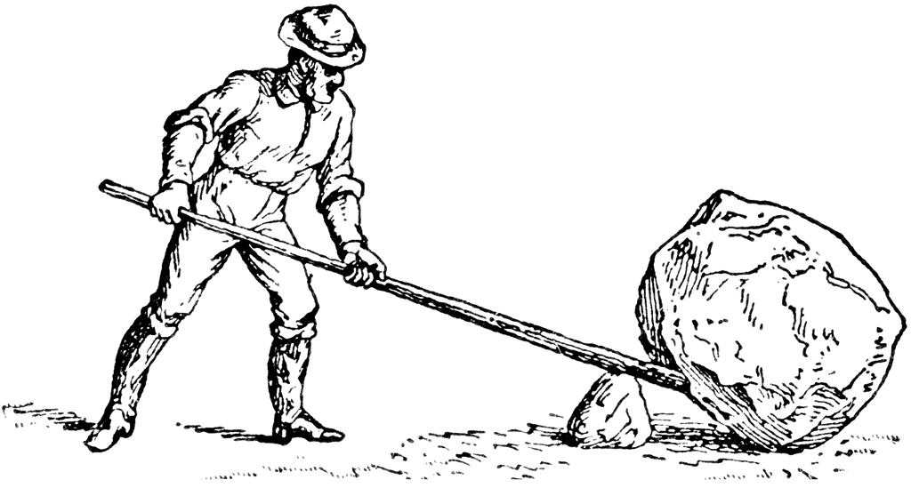
Instead of trying to lift an object from the side, a lever will allow you to lift it across a beam
This allows you to lift the object up with more strength because you can get all of your weight behind it!
The longer the beam,
the greater the mechanical
advantage!

Slide 11
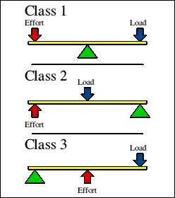
Types of Levers
First Class Lever: the fulcrum is located in between the effort and load
Second Class Lever: the load is located in between the effort and fulcrum
Third Class Lever: the effort is located in between the fulcrum and load

Slide 12
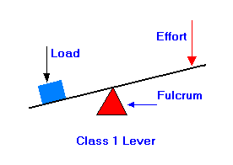
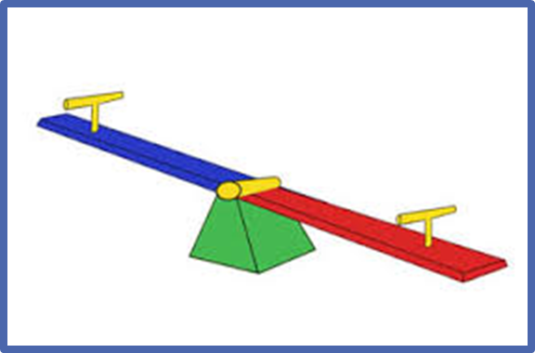
Types of Lever: First Class
example

Slide 13
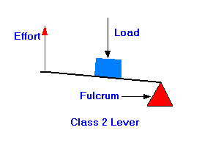
Types of Lever: Second Class
example

Slide 14
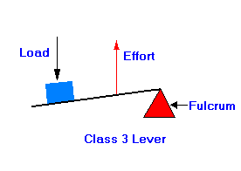
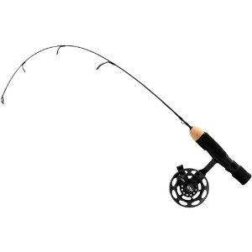
Types of Lever: Third Class
example

Slide 15
Let’s try it!
Use different types of levers to lift different weights!
Write down your observations

