Slide 1
Inclined Plane
Simple Machines

Slide 2
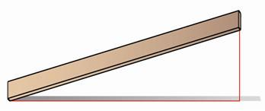
Inclined planes are used to help move heavy objects up a certain height

Slide 3
What is an inclined plane?
Click here to load video
on YouTube
Click here to load video
on mocomi.com

Slide 4
What is an inclined plane?
Inclined plane: a simple machine that is used to spread out the force needed to move an object
By moving in small, gradual steps instead of all at once, it becomes easier to move objects up a certain height

Slide 5
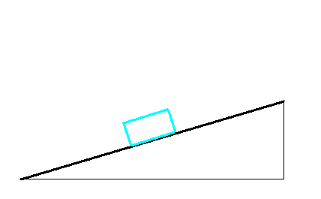
They work by using a long surface to create a ramp where one side is higher than the other
Objects can be moved up or down the ramp
ramp
height

Slide 6
Moving an object gradually over a longer distance is easier than lifting it by hand
load
force

Slide 7
What are some examples of inclined planes you might see in your daily lives?

Slide 8
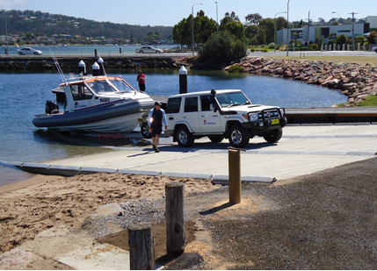
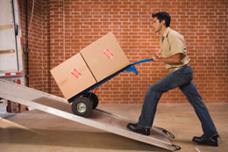
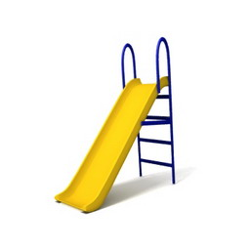
What are some examples of inclined planes you might see in your daily lives?

Slide 9
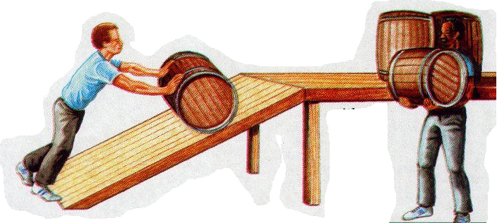
Inclined planes are used when objects have to be moved up to a height that is difficult to lift up to by hand

Slide 10
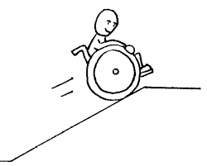
Instead of trying to lift an object up high all at once, an inclined plane will allow you to lift it gradually across a greater distance
This allows you to push the object slowly up a slope which is easier to do!
Inclined planes also make it
easier to go down the ramp!

Slide 11
Types of Inclined Planes
Slope: the angle that the inclined plane is set up at
The greater the slope, the more difficult it is to use an inclined plane
Long ramps set at a low angle create an easy slope to move objects up
This increases the mechanical advantage!

Slide 12
Types of Inclined Planes
hard slope
easy slope
high angle
low angle

Slide 13
Let’s try it!
Use different types of inclined planes to move different weights!
Write down your observations

