Slide 1
Wheel and Axle
Simple Machines

Slide 2
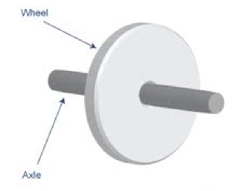
Wheel and axles are used to help move heavy objects more easily

Slide 3
What is a wheel and axle?
Click here to load video
on YouTube
Click here to load video
on mocomi.com

Slide 4
What is a wheel and axle?
Wheel and axle: a simple machine that is used to change circular motion into forward motion
A wheel reduces the friction between an object and a surface, making it much easier to move

Slide 5
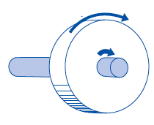
They work by spinning the axle attached to a wheel, transferring the force forward over a larger distance
wheel
axle

Slide 6
The axle is firmly attached to the wheel
As force is applied to spin the axle, it is transferred to the wheel
The wheel reduces the friction that would be put on an object by dragging it along the ground
force

Slide 7
What are some examples of wheel and axles you might see in your daily lives?

Slide 8
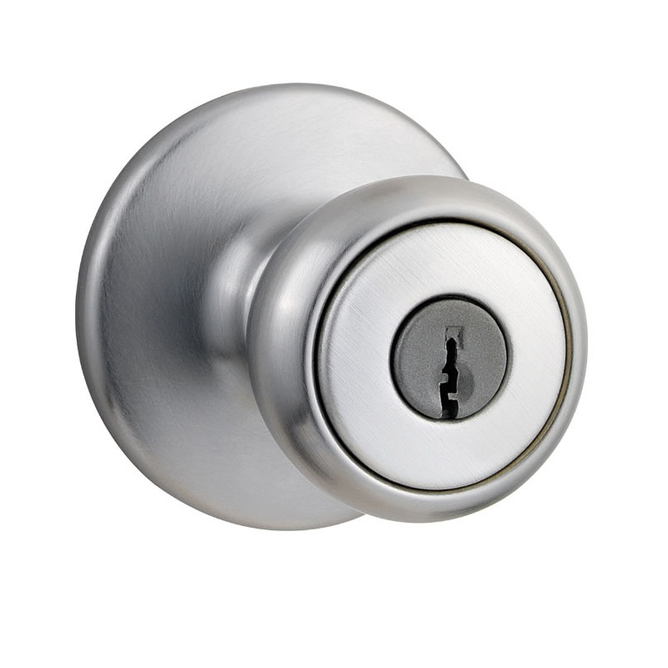
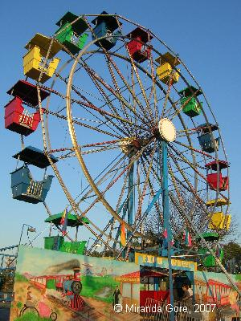
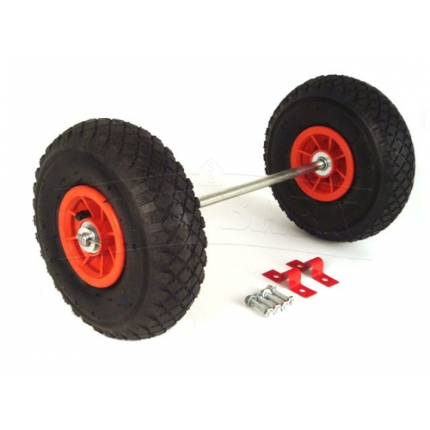
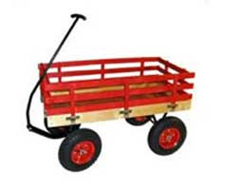
What are some examples of wheel and axles you might see in your daily lives?

Slide 9
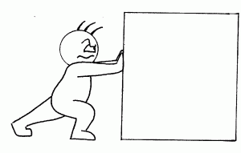
Wheel and axels are used when objects have to be moved over long distances
Using a wheel and axle greatly reduces the friction put on an object as it moves along the ground

Slide 10
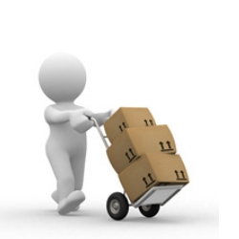
Instead of a whole object being slowed by friction, only the wheels underneath have any contact with the ground
This allows the object to be moved with ease!

Slide 11
Types of Wheel and Axles
Fixed Axle: when the axle is firmly attached to the wheel
The rotation of the axle is transferred into forward motion of the wheel
When an wheel is not fixed in place, it is able to turn independent of the axle
This is found in pulleys!

Slide 12
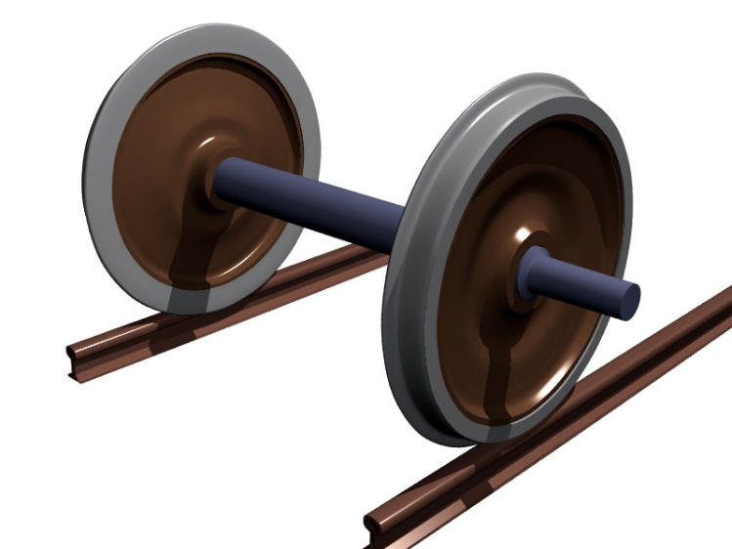
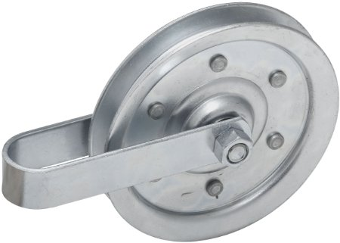
Types of Wheel and Axles
fixed
not fixed

Slide 13
Let’s try it!
Use different types of wheel and axles to move different weights!
Write down your observations

